Slide 1
Welcome Moment VLIR-UOS-scholars
Ellen
Van Himbergen

Slide 2
Contents
Report on the Belgian situation : fight for funds and a secured future
Evaluation of university cooperation for development

Slide 3
1. Report on the Belgian situation (2011-2013)
VLIR-UOS
CIUF-CUD
Both, so far, exclusively funded by the federal state, Belgian ministry for development cooperation : ± 35 mio EUR / year

Slide 4
Two “lost” years : 2011-2013

Slide 5
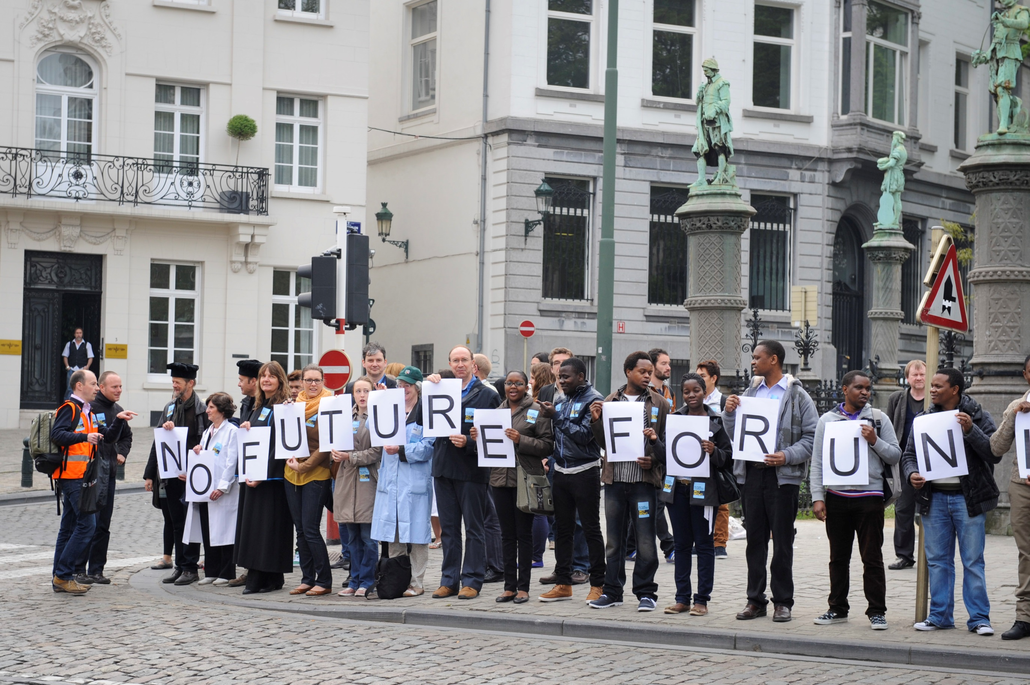

Slide 7
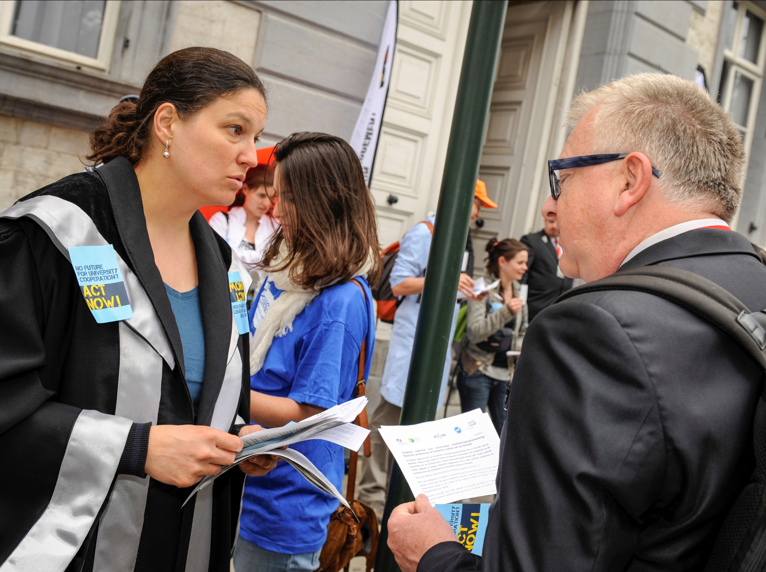

Slide 8
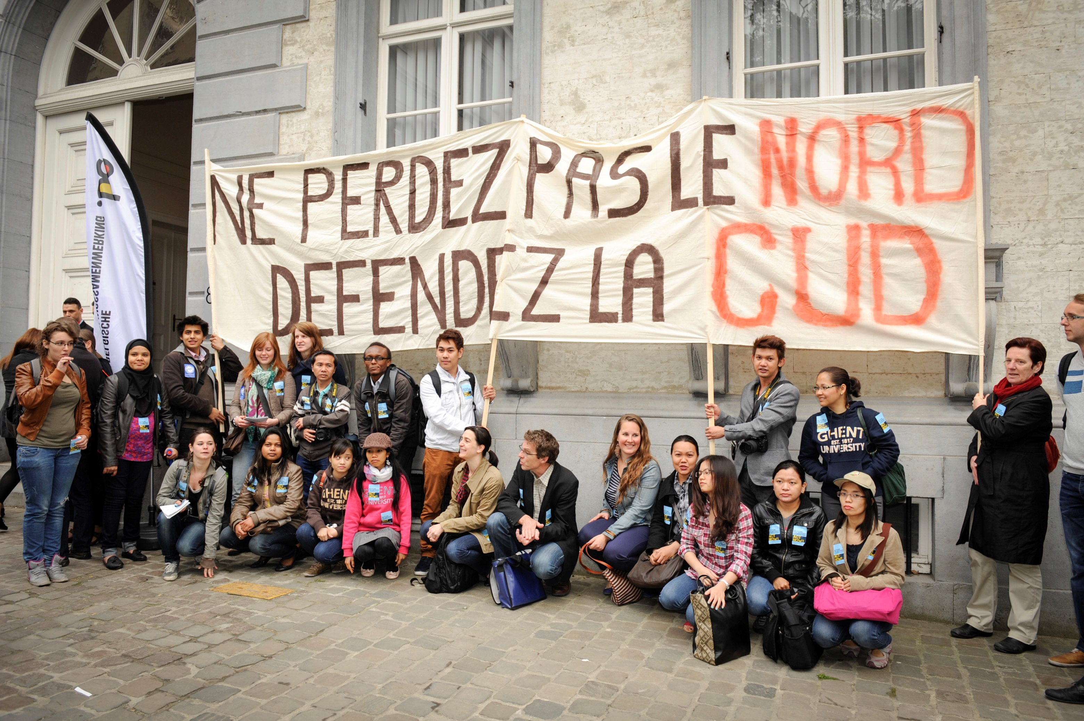

Slide 9
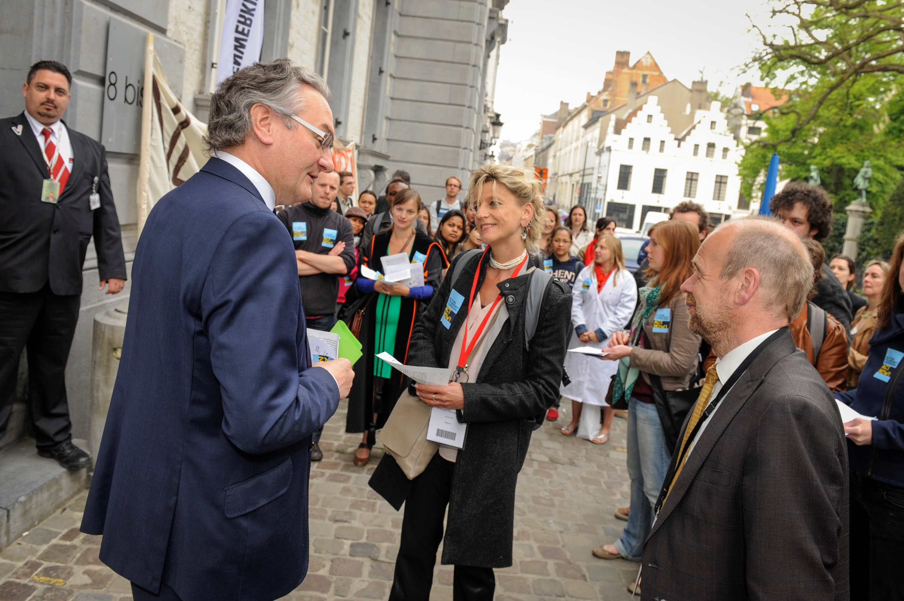

Slide 10
Budgets
2011-2013
Very late decision on budget
Impact on implementation of activities / spending rate
2013 : “horror”
Until mid July 2013 : 67% budget, budget cut of 11 mio EUR, very hard decision
Mid July 2013 : release of 33% + structural solution for the “political” problem

Slide 11
Impact (2013)
Internal conflicts :
Universities/university colleges
umbrella organisation/split budget per university
higher education/basic education
south/north programmes
funding programme for foreign students, …
Damage to ongoing projects; delays; low spending rate
Damage to reputation, in Belgium and abroad : governments, universities, academics, ….

Slide 12
What was at risk ?
Autonomy of the academic sector
Scientific freedom– right to initiate
Open calls, competitive peer based selection
Cooperation model : beyond borders of countries, institutions, disciplines
Budget
VLIR-UOS as organisation

Slide 13
What saved us ?
Activism of all involved
Political pressure (formal and informal)
Media pressure
Legal arguments
Prospect of budget cut, felt at the level of the Flemish universities and university colleges
But :
No public debate (parliament)
Overall trend worldwide

Slide 14
2014-2016
Budget 2014 :
big budget cut in development cooperation, already in 2012 and 2013, yet again in 2014
at the level of 2009, although 0,7% BNP committed
Surprisingly not in “indirect cooperation” (!!)
Calls for 2013 and 2014 : combined, in very short period of time
Belgian development cooperation
New structure for coordination among non-governmental actors to be set up
Joint context analyses per country
Accreditation procedure

Slide 15
First priority for VLIR-UOS
Pacification, restauration of confidence within the entire network
Return to “normal” cycles of calls, selections
Return to normal ambition to continuously optimize concepts, formats and frameworks, … through consultation, benchmarks, studies,….

Slide 16
Lessons learned
Diversification of funds
Communication strategy

Slide 17
Priorities for the years to come
Diversification of funds
Multiactor projects
Communication strategy
Country strategies / programme / platforms
Platforms for exchange of information / cooperation
Risk management
Organisational structure

Slide 18
Elections in 2014
What next ????

Slide 19
2. Evaluation of university cooperation for development
Evaluation policy
Project / programme evaluation :
Ex ante : selection
Midterm evaluation
End of programme evaluation
Thematic evaluations
Methodology :
Logical framework approach
Self-evaluation + external evaluation
Project specific indicators + KRA + soft indicators (partnership, cooperation)

Slide 20
2. Evaluation of university cooperation for development
Main outcomes
Results highly dependent upon context; need to adapt toolbox
Longterm commitment is key issue
Focus on partnership
Local ownership is a challenge
Upscaling impact through synergy / complementarity with other actors remains a challenge

Slide 21
2. Evaluation of university cooperation for development
Lessons learned / new policy lines
Toolbox differentiation
Country strategy identification
Personal assessment
Failing cooperation, hard to fix
“Volunteers”, discipline experts, not experts in change management …
Value for money
Context : enabling environment, how to influence ?

Slide 22
Kristien Verbrugghen
Kristien.verbrugghen@vliruos.be
www.vliruos.be

