Slide 1
‘Yozma’ & The Israeli VC Landscape
Yossi Vinitski, October 2013
“Knowledge as an economic driving force:
the case of Israel”

Slide 2
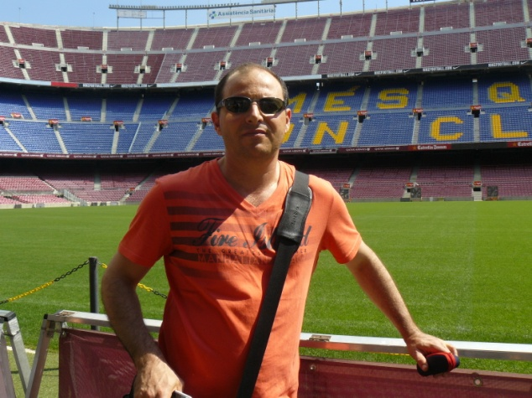
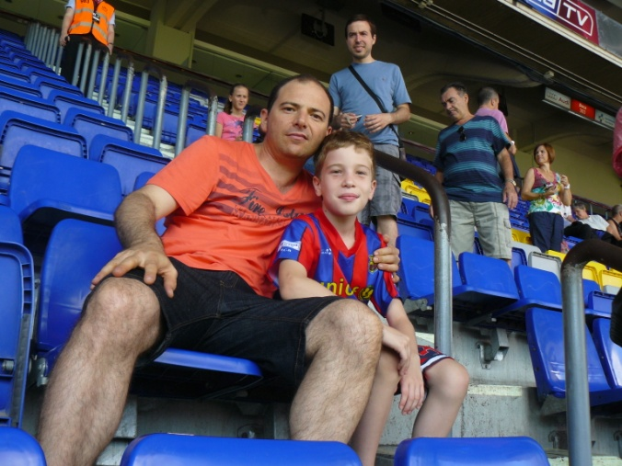
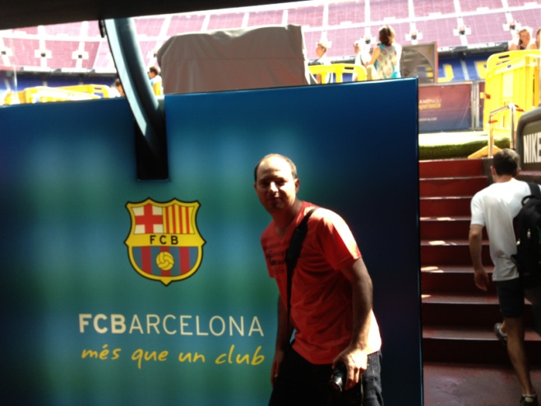
Yossi Vinitski Barcelona August 2013

Slide 3
Yossi Vinitski VC Career
1995-2000
Senior Investment Manager
2000-2013
Partner
Bs.C Mechanical Engineer
MBA

Slide 4
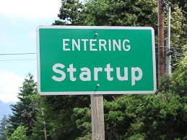
2013 H1 Summary

Slide 5
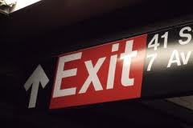
2013 H1 Summary
$4.9B Israeli hi-tech exits
10 Deals of more than $100M

Slide 6
2013 H1 Summary
$1B
$0.9B
$0.475B

Slide 7
2013 H1 Summary
312 Israeli hi-tech companies raised $967M

Slide 8
2013 H1 Summary
$763M (79%) VC investments in 184 companies

Slide 9
2013 H1 Summary
$265M Israeli VC investments (27% )
60% deal participation

Slide 10
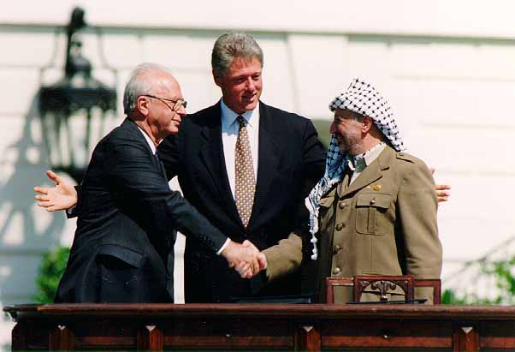
Yozma
Yozma is the Hebrew word for initiation

Slide 11
Yozma
Mission:
To create a venture
capital market in
Israel
.
Establish a $100M Government investment company

Slide 12
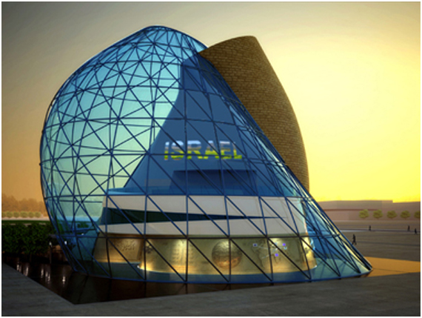
Yozma
Policy:
Create professionally managed Funds
Entice VC investments in Israeli early stage companies:
(i) create & invest in new VC funds together with experienced partners
(ii) make direct investments in startup companies together with professional investors

Slide 13
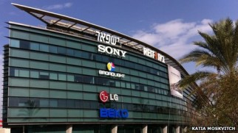
Yozma
Investment method in Funds:
Investment of $8M in each $20M drop-down fund (minority position)
5 years option to buy out Yozma’s share at predetermined conditions
Yozma’s CEO / VP was a voting member on each Fund’s investment committee
Same terms for all VC Funds

Slide 14
Yozma
Results:
Established 10 funds together with strategic partners
15 Direct investments
Out of the 10 funds 8 have exercised their option
9 exit’s of Yozma’s direct investment portfolio
Yozma fund’s size 10 years later: from $210M to $4B
The Yozma vehicle was privatize
The Israeli VC industry has been established

Slide 15
Israeli VC Arena
Local VC Brands
Foreign Funds
Most of the L.P.’s
are foreign

Slide 16
Israeli VC Arena
Local Brands
Few big general funds
(all stages, all tech)
Specialized fund
(Medical, Internet)
Micro funds ($5-25M)
(New, due to the fundraising difficulties)

Slide 17
Israeli VC Arena
Foreign Funds
Israel dedicated Funds
General allocation from main fund (Strategic / Opportunistic)
Corporate funds
Super angels, Micro funds

Slide 18
Israeli VC Eco System
Entrepreneurial Culture
OCS
Accelerators
Incubators
Army
Universities
Lawyers/Accounting firms
Multinationals

Slide 19
Israeli VC Eco System
Multinationals

Slide 20
fsf
yossi.vinitski@gmail.com

