Slide 1
Creating a High-Performance
Innovation Ecosystem:
The Massachusetts Life Sciences Initiative
International Seminar on Knowledge and Innovation
1 October, 2013

Slide 2
About the Massachusetts Life Sciences Community

Slide 3
Massachusetts Is the Global Leader in Life Sciences
The world’s leading life sciences community:
  #1 in Science & Technology (Milken Institute),
  #1 Life Sciences Cluster (Jones Lang LaSalle)
  #1 in Biotech Construction (Richards Barry Joyce)
World-class academic and medical institutions
Multiple industry sectors -- biotechnology, pharmaceuticals, medical devices, diagnostics and bioinformatics
Highly educated workforce that is well-distributed across the state
#1 in U.S. in life sciences employment per capita, with nearly 14,300 life sciences jobs per 1 million people
Government leadership,
  10-year, $1-billion Life Sciences Initiative (enacted by the Massachusetts Legislature in June 2008)

Slide 4
Life Sciences Are Critical to Our Economy
Life sciences employment growth in Massachusetts has been outpacing the nation by 2-to-1.
2011
95,615*
27.3%
Growth
Since
2001
2001
75,085
Source: U.S. Bureau of Labor Statistics,
Quarterly Census of Employment and Wages (QCEW)

Slide 5
What is the Massachusetts Life Sciences Center?

Slide 6
The Massachusetts Life Sciences Initiative Has a Wide Scope
Innovation-Driven Economic Development and Job Creation
Biotech, Pharma,
Medtech, Diagnostics and
Bioinformatics
Public-Private Funding Partnerships
to Highly Leverage Investments
Massachusetts Life Sciences Center
$1B (U.S.)
10 years
Grants for Translational Research and Industry-Academic Partnerships
Creation of Novel
Infrastructure and Consortia
to Accelerate the
Pace of Innovation
Workforce Development
Programs
Investments in Entrepreneurship
and Early-stage Companies
International Collaboration

Slide 7
The MLSC Invests to Close Gaps Across the Innovation Life Cycle...
Discovery
Development
Delivery
The MLSC Strategy:
Reduce barriers, fill gaps and promote collaboration across the life sciences innovation process
Promote and fund convening and collaboration
Partner with and leverage private sector stakeholders
Invest in early stage companies (pipeline and external innovation)
Support workforce development and training
Build capacity, infrastructure and unique resources in Massachusetts
Fund translational research

Slide 8
…and Coalesce the Massachusetts Life Sciences “Cluster” into an “Ecosystem”
Life sciences innovation thrives in Massachusetts because of the great concentration of universities, research hospitals, educated workers, entrepreneurs, mature companies and a strong investment community.
  In a high-performing innovation clusters these components work well individually and together as an ecosystem.
550 Biopharma Companies
500 Medtech Companies
Top 4 NIH- Funded Research Hospitals
1st in Venture Capital Funds
1st in Federal Research Funds
1st in Educational Level of Workforce (U.S.)
122 Colleges & Universities
550 Biopharma Companies
500 Medtech Companies
Top 4 NIH- Funded Research Hospitals
1st in Venture Capital Funds
1st in Federal Research Funds
1st in Educational Level of Workforce (U.S.)
MLSC Investments
122 Colleges & Universities

Slide 9
MLSC Has a Variety of Investment Tools
$250 Million
Tax Incentive Program
10 Years
$1 Billion
Investment
$500 Million Capital Fund
$250 Million Investment Fund
(subject to appropriation)

Slide 10
There Is Much Evidence of the MLSC’s Impact to Date
Engagement by the life sciences community
  Unprecedented participation from industry, and the academic, medical, entrepreneurial and venture communities
Leverage
  Halfway through the 10-year initiative, the MLSC has invested nearly $500M but leveraged $1.2B of matching investments
Job creation
  Life sciences are now fastest job-creating sectors in the state
  MA is creating new life sciences jobs faster than any other state
10 of 10
  All 10 of the top 10 global biopharma leaders are present in MA
National recognition
  National award for excellence in innovation and technology-driven economic development

Slide 11




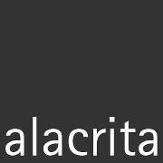







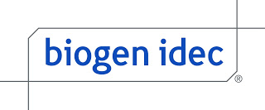










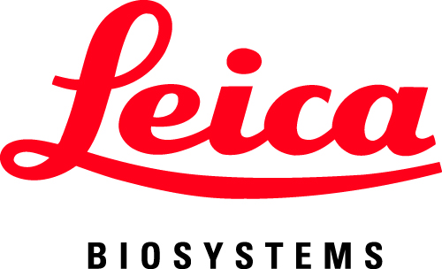


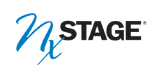



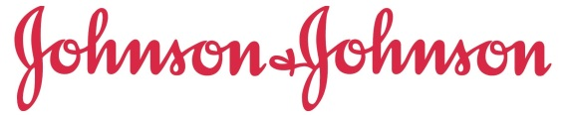
















More and More Companies Are Creating a Footprint in the Massachusetts Life Sciences Community:
2008 - 2011
2012
2013
10 of 10!

Slide 12
What Have We Learned?
New model of economic development
Innovation sectors require a different model of investment
“Bottom-up” investing vs. “top-down”
Program administration
Awards based on competitive process
Investment decisions guided by external multi-disciplinary experts (i.e. “wisdom of crowds”)
Portfolio approach
Array of programs to fill critical gaps
Recognizes that innovation requires multiple enabling factors

