Slide 1
Analysis of The Israeli Venture Industry and Future Directions
Israel’s Startup Eco- System

Slide 2
Israel at a glance
Israel has limited natural resources
Antagonistic relations with neighboring countries
Highest density of startups
30 times Europe, 80 times India, and 300 times China
Attracts more venture capital per person than anywhere in the world
Produces more Nasdaq-traded tech companies than anywhere else outside of Silicon Valley

Slide 3
Israel at a glance
Population: 8 Million
Area: 22.1K sq.km
The past 3 Years (2010- 2013):
GDP 2012: 250$b, per capita: 31$K
High- Tech exports: ~50B$ Annualy
Unemployment: ~6.5%
OECD full membership
** source: IVC & GIZA

Slide 4
Israeli hi-tech
40% of the Annual GDP growth
50% of industrial exports
10% of total employees in the market
Return of 3X on each dollar invested in R&D
Attracting foreign investors
6,000 start ups in the past decade
Leveraging human capital in Israel
** source: IVC & GIZA

Slide 5
Israeli Start ups

Slide 6
Entrepreneurship In Israel
Public Sector
Chief Scientist
Mati
MFA Support
MOITAL
Private Sector
5,000 Start Ups
100,000 Hi Tech employees
Start Up Eco System
Academic Sector
StarTau
Zell IDC
Bronitza
SifTech

Slide 7
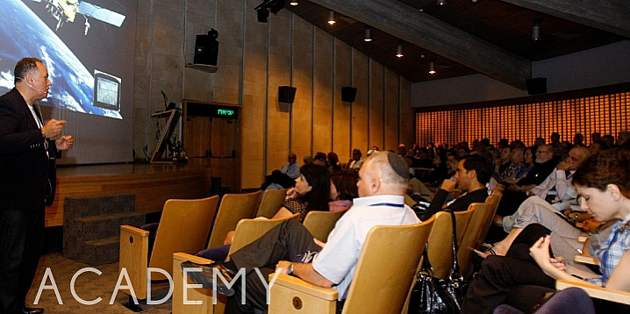
Academy

Slide 8
Entrepreneurship Centers
Services | Location | Name
Mentoring + Training + Community, International | TAU | StarTau
Activities + Mentoring | Technion | Bronitza
Mentoring + activities | BGU | Bengis
Academic content + Connections | IDC | Zell
Workspace + Mentoring + Activities | TLV JAFFA College | Hamitham
Mentoring + Activities | Open U | Open Uni.
Mentoring + Training + Community | Hebrew U | Siftech

Slide 9
TTOs
Tech Transfer Offices- commercializing research
Ramot- TAU
Yeda- Weizmann Institute
Yisum- Hebrew Uni
T3- Technion (Haifa)

Slide 10
Private Sector

Slide 11
Accelerators
Providing startups with pre-seed capital / education / connections.
Usually- 5-10 teams X 3 months cycle.

Slide 12
Accelerators
Services | Name
WorkSpace + Activity | Hub TLV
WorkSpace + Activity | Junction
WorkSpace + Activity | Library
WorkSpace + Activity | Techloft
Investments (Equity)+ WorkSpace + Activity | Elevator
Activity + Mentoring | 8200
WorkSpace + Activity + Mentoring | Microsoft
WorkSpace + Activity + Mentoring | Google
Taking equity + Mentoring + Activity | Founders Institute

Slide 13
VCs
The local VC industry is characterized by a small workforce, composed mainly of GPs with strong technological as well as financial background.
The industry serves as an anchor to foreign VCs’ who are the main channel through which foreign funding flows to Israeli hi-tech firms.

Slide 14
VC structure
LP, LP, LP -> GP
20% Carry
2% annual management fee
50~ operating in Israel
Recent news: Aleph (Michael Eizenberg- Benchmark Capital and Eden Shohat-Face.com/Genesis)- 140M$ fund.

Slide 15
VCs - The rise
Gov. decision 1993: to start a viable VC industry (allocated $100 million for that purpose).
A fund of funds - Yozma (which means initiative in Hebrew) was established. Under the Yozma initiative, 10 venture capital funds were formed in partnership with leading foreign venture investors.
The total capital of each fund was $20 to $25 million of which the government's share was 40% and the foreign investors' 60%.
10 VC funds were formed with a total of $210 million under management and 15 direct investments that were made by Yozma itself.
Nine out of the fifteen direct investments enjoyed successful exits, either through IPO's or through acquisition (Exit).

Slide 16
VCs - The fall
KAUFFMAN REPORT : BROKEN VC, GUILTY LPS, AND THE WAY FORWARD.
Private Equity funds
Vc are firing back- the report does not cover our best years (2011- 2013), after the crisis

Slide 17
VCs - Numbers
1997- 2012:
24$ Billion invested in the VC sector
M&A: 37$ Billion, IPOs: 4$ Billion
2012 | 2011
1.9$B | 2.1$B | Total Investment
9.7$B | 5.2$B | M&A Exits
25 | 24 | Incubators
30 | 24 | Accelerators
537 | 700 | New startups

Slide 18
VC Global Comparison
VC Investments 2012 | Country
1.9$B | Israel
26$B | U.S
4$B | Europe & UK
3.7$B | China
1.6$B | India
Israeli VCs are very active in Seed and Early stage investments, while the Foreign investors operating in Israel are more involved with the later stages (Mid/Expansion/Late).
** source: IVC & GIZA

Slide 19
VC Investments by sectors (2012)

Slide 20
Angels
Who are:
Yossi Vardi
Yaron Carni
Zohar Gilon
Yaniv Golan
Yanki Margalit
Gigi Levi
Guy Gamzu
Daniel Recanati
Jeff Pulver

Slide 21
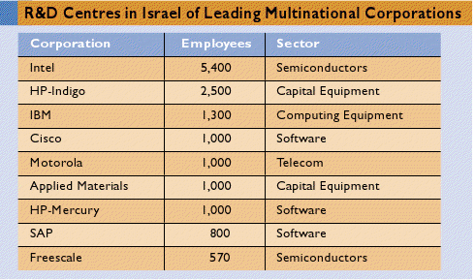
Research & Development (R&D) Centers
In 2007 the percentage of expense on R&D from the GDP was the highest of all OECD countries.
Why do they enter Israel and how?

Slide 22
Media
News Coverage
News Coverage
News Coverage
News Coverage
Startup info (incomplete)
Costly Start up Info

Slide 23
Micro Funds and super angels
Micro funds are managing between 5-50M$ per fund, and are involved in early stage investments.
Inimiti- A relatively new micro fund (operating from a kibbutz in Herzelia).
Kaedan Capital- a group of angels investing together out of their own pockets.

Slide 24
Public

Slide 25
Public - Mati
Mati is a network of entrepreneurship centers owned by the Ministry of Economy.
25 branches all over Israel: assisting SMEs and Startups.
Services: Mentoring, BP writing, classes, loans, strategic consulting.

Slide 26
Public - CSO
R&D fund
Incubators (15%-85%)- 26 In Israel
Magnet: Tech Transfer
Special Projects: grants for research
International Activity: Multinational R&D centers, EEN, Eureka, Bi-national funds
Tnufa- 50K$ grant: 500 apply each year, 30% get Tnufa funding

Slide 27
Public
Municipalities (TLV Library)
Chamber of Commerce
Manufacturers Association
Export Institute
Ministry of Foreign Affairs- Economic dept.
Invest in Israel – Ministry of Economy
Commercial Attaches (abroad)

Slide 28
Additional Factors
In the next few slides….

Slide 29
Chutzpah
Borrowed from Yiddish, Chuzpah is defined as “gall, brazen nerve, effrontery, incredible ‘guts,’ presumption, plus arrogance such as no other word and no other language can do justice to.”
Chuzpah is everywhere in israel
From universities - students relationships with professors, employees challenging their bosses, sergeants towards their generals, even in the government
Challenge the apparent, ask a lot of questions, debate everything, assertiveness

Slide 30
Kibbutzim
The high-tech Agri industry in Israel originated also from kibbutzim:
Since Israel has very limited resources, these communal farms must come up with innovative technology to progress.
Agricultural innovations
Israel is the agricultural leader in the world
Water problems (desalination)

Slide 31
Israeli Defense Force
Anti-hierarchical
The army helps companies financially
Networking gained in the military is a huge benefactor in the business world
Problem solving & decision making is dealt with from all ranks
Israelis come out of the military with hands-on exposure to next-gen technology, training in teamwork, mission orientation, leadership, and a desire to continue serving their country by contributing to its technology sector
Life experience

Slide 32
Immigrants - natural risk takers?
Government is supportive of immigration
Two out of every three Israelis are newcomers, or the children or grandchildren of newcomers

Slide 33
Problems faced by Israeli Startups
Lack of funds (VCs making less investments)
Marketing strategy
Small domestic market
Lack of research (understanding its importance)
Lack of mentors- AVG 2 (Silicon Valley- 4)

Slide 34
Future Direction
Angel clubs- Syndicates of angel investors
Crowdfunding- a way to sponsor projects online:
Benefits based.
Equity based.

Slide 35
THANK YOU

