Slide 1



Gustavo Fuchs – Business & IP Intelligence Officer
An Introduction to Yissum

Slide 2
Agenda
Yissum
Origins
Technologies Available
A glimpse at the Present
Success
Dealing with New Technologies

Slide 3
Yissum
Applying Knowledge

Slide 4
Yissum’s Mandate (From HUJI’s Management Rules)
Yissum Research Development Company of the Hebrew University of Jerusalem Ltd. is an independent corporation wholly owned by the Hebrew University.
Funded in 1964, Yissum has authority to deal with the Inventions generated in the Hebrew University due to an Agreement between Yissum and the University
Basically this Agreement allows Yissum to deal with all aspects of the Inventions, according to the HUJI Internal Regulations only.

Slide 5
Yissum’s Mandate (From HUJI’s Management Rules)
The Agreement allows Yissum to:
  Be the University’s proxy in dealing with inventions, patent submissions and their exploitation,
  Represent the University in anything related to industrial and commercial exploitation of results arising from the University’s research,
  Initiate communication between university employees and members of the economic or industrial community for the purpose of supporting research that is being done at the university and their commercial achievement
  Initiate economic cooperation with entrepreneurs
  Yissum owns all IP invented by HUJI researchers

Slide 6



Yissum’s Business Model
University
Industry
Government
Investors
Researcher
Laboratory Capabilities
Available Technologies
Collaborative Research
Spin Off Company
Tech. Transfer Agreements

Slide 7
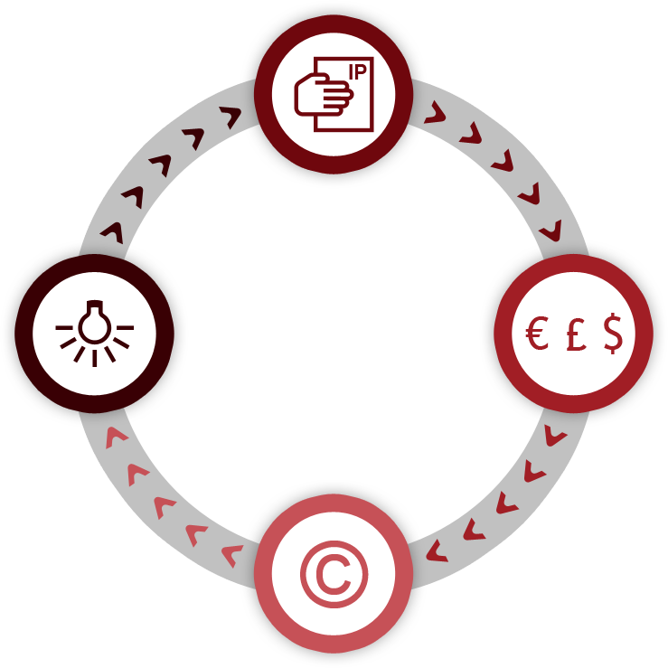

The Technology Transfer Process
Yissum evaluates, protects the IP and commercializes it
HUJI researchers discover new invention &
submit disclosure
The Industry partner pays Yissum for the license to use its IP
Research Money
Yissum pays royalties to the researchers and HUJI

Slide 8

The Research Collaboration Process
Company
Defines scope of work & budget and works closely with the researcher to ensure research
results
Yissum
Negotiating & executing the agreement
Researcher
Performing scientific work

Slide 9
Income Distribution

Slide 10



The Chain
Non-profit
organization
Business leaders
Business-oriented
organization
Notes:
10

Slide 11
Yissum’s Organizational Structure
CEO
Finance
Department
Marketing & PR
Legal
Department
IP
Department
Business Dev.
Department
Research
Collaborations
Information &
Projects Evaluation
Patent
Attorney
Agriculture
Physics & Chemistry
Materials
Biotechnology
Veterinary Med.
Medical devices
Pharmaceuticals
Computer Science
Environment

Slide 12





The Hebrew University: A Source of Excellence
43% of Israel’s biotechnology research
30% of all Israeli academic scientific research
>1/3 of PhD students in Israel
23,000 students
1,000 researchers (staff members)
1,600 Post-Graduate students in biotechnology
5 affiliated hospitals
6 Campuses
3,500 Research projects
>100 Research centers
Over 400 Researchers in applied sciences
Notes:
12

Slide 13

The European Research Council – 2007-2011 Starting Grants Rankings
Rank | University | Total # Grants
1 | Cambridge, UK | 47
2 | Oxford, UK | 38
3 | Hebrew University, Israel | 29
4 | University College, UK Centre National de la Recherche Scientifique Ecole Polytechnique Lausanne, Switzerland Imperial College of Science, UK | 23
5 | Commissariat a l’Energie Atomique, France | 22
6 | Weizmann Institute, Israel | 20
7 | Katholeik Universitait Leuven, Belgium | 18
8 | Technion- Israel Institute of Technology INSERM, France | 17
9 | Rijksuniversiteit Groningen, Netherlands | 15
10 | Helsingin Yliopisto, Finland | 13
European Research Council
Extremely competitive infrastructure research grants, for which the entire EU university base (inc. Israel) compete

Slide 14
Technologies
Areas of Expertise

Slide 15








Areas of Expertise
Pharmacology and Medicine
Agriculture
Brain Research
Engineering and Computer Science
Nanoscience and Advanced Materials
Cleantech
Education
Veterinary

Slide 16
A glimpse at the present
A current snapshot

Slide 17

49 Years of Transferring Technologies
8,155 patents
2,302 inventions
702 licenses
80 spin-offs
Products based on Hebrew University technologies & commercialized by Yissum generate over $2 billion in annual sales

Slide 18

Israel Tech Transfer Organization
Yissum’s innovations reflect 40% of the total number of projects available for licensing by Israeli technology transfer companies.
Yissum -
a leading member of the ITTN *
* By number of available technologies
Notes:
18

Slide 19
Intellectual Property
2012 Snapshot
182 new inventions
64 new patents granted
Intellectual Property at HU
Yissum owns all IP developed at HU
Researchers receive 40-60% of revenues
A variety of new inventions
Humanities 2%

Slide 20
Projects Available for Licensing 2013
Over 400 technologies
Notes:
20

Slide 21
Yissum’s Biotech Product Pipeline:
Phase I
Phase II
Phase III
Vekacia ® (Novagali)
Cyclokat ® (Novagali)
Yissum
Israel*
Ladostigil, (Avraham)
BC819 (Biocancell)
Anti Angiogenic (Tiltan)
Phase III
MRX4 (Morria)
MRX6 (Morria)
Acc. Levodopa (Intec)
Acc. Zalepon (Intec)
LABR-312 ( Biorest)
CatioProst ® (Novagali)
Phase II
BL7040 (Bioline Rx)
AB103 (Atox Bio)
PRX105 (Protalix)
Apocell (Enlivex)
CCS/C (Nasvax)
EPOdure (Medgenics)
Phase I
Protexia (Pharmathene)
Acc. Baclofen (Intec)
Cortiject ® (Novagali)
*Source: ILSI Database - 2010
MM-002 (Moebius)
Promitil (Lipomedix)

Slide 22
Success

Slide 23





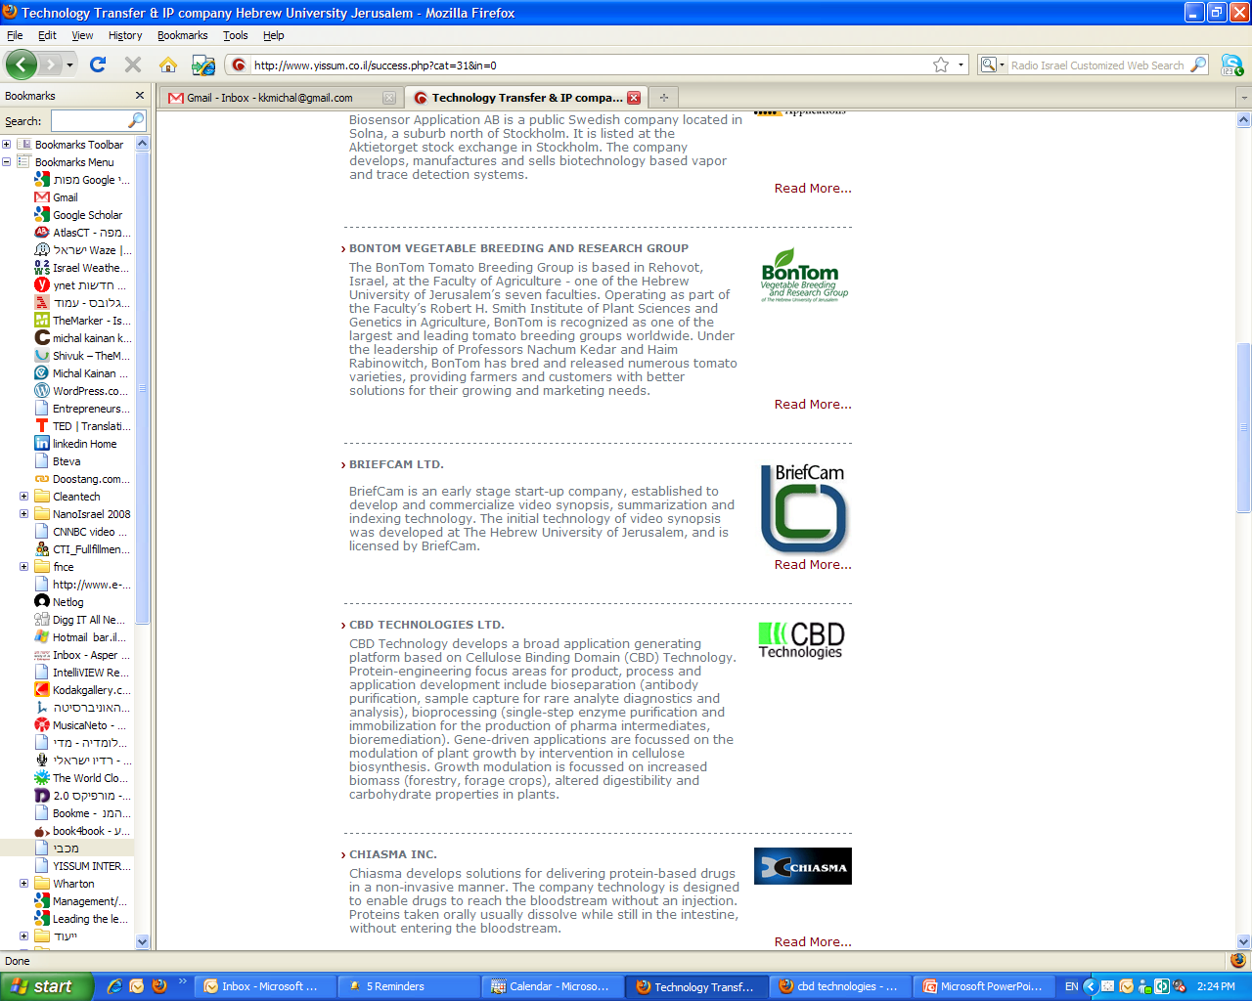


























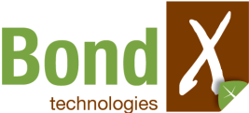

80 Spin-Off Companies
LipoMedix
23
Notes:
23

Slide 24













Global Reach

Slide 25
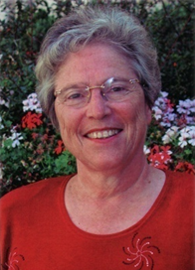
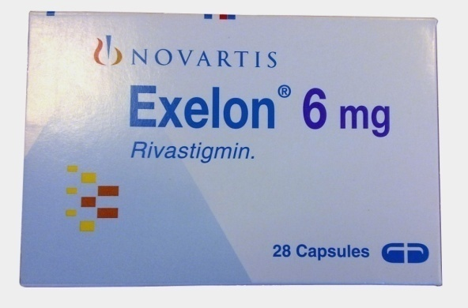



Success Stories - Exelon
Exelon®
For Treatment of Symptoms Alzheimer’s Disease and Dementia
Prof. Marta Weinstock-Rosin
Department of Pharmacology, Faculty of Medicine
The Hebrew University of Jerusalem
2012 sales over $1 Billion
Notes:
25

Slide 26
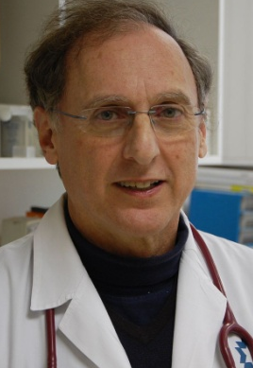
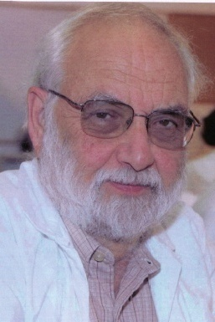
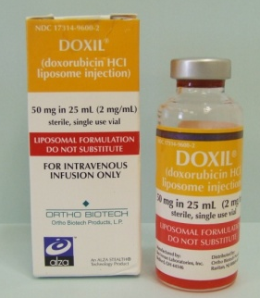


Success Stories - Doxil
DOXIL® - Doxorubicin HCI liposome injection
Alza’s Lead Product for Oncology
Prof. Yechezkel Barenholz
Department of Biochemistry, Faculty of Medicine
The Hebrew University of Jerusalem
Prof. Alberto Gabizon
Hadassah University Hospital Jerusalem
2012 sales over $500 million
Notes:
26

Slide 27
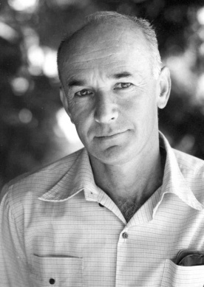
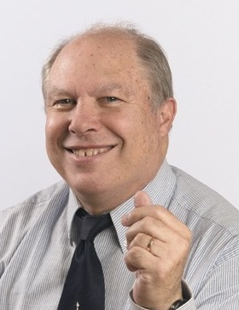
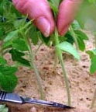
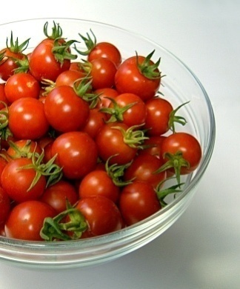

Success Stories - Tomatoes
Long Shelf Life Tomatoes
The world’s most popular cocktail hybrids for year round greenhouse production
Prof. Nachum Kedar
Prof. Haim Rabinowich
Department of Field Crops, Vegetables and Genetics:
Faculty of Agriculture, Food and Environmental Sciences
The Hebrew University Rehovot Campus

Slide 28

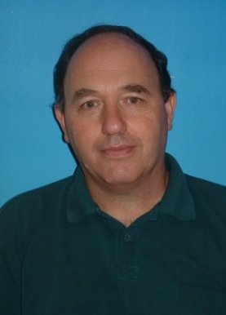



Success Stories - Peppers
Hybrid Peppers
Breeding of Blocky type pepper hybrids for growing under mild winter conditions. Market leader in Spain, Israel & Mexico In collaboration with Zeraim Gedera (Fully owned by Syngenta)
Dr. Yonatan Elkind
Department of Field Crops, Vegetables and Genetics:
Faculty of Agriculture, Food and Environmental Sciences
The Hebrew University Rehovot Campus
Notes:
28

Slide 29
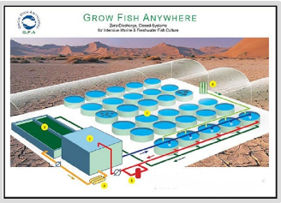
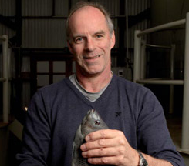

Success Stories - Grow Fish Anywhere (G.F.A)
GFA Advanced System Ltd.
Zero Discharge Recirculating System for intensive culture of freshwater and marine fish. The system prevents environmental pollution, uses water economically, and can be operated in any climatic conditions.
Prof. Jaap van Rijn
Faculty of Agriculture, Food and Environmental Sciences
The Hebrew University Rehovot Campus
Notes:
29

Slide 30

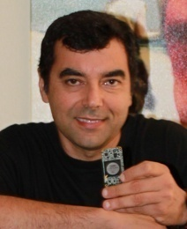
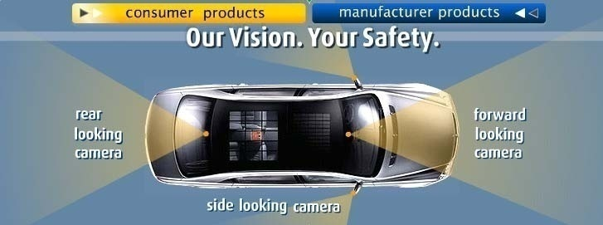

Success Stories - Mobileye
Mobileye
Advanced vision based driver assistance system for accident prevention
Prof. Amnon Shashua
Computer Science & Engineering, Faculty of Science
The Hebrew University of Jerusalem
2010 Valuation of $740 million
(Investment by Goldman Sachs & others)
Notes:
30

Slide 31
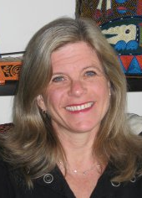


Success Stories – Hippy International
HIPPY® - Home Instruction for Parents of Preschool Youngsters
Providing parents the tools and support they need to help their children learn in their own homes.
Dr. Miriam Westheimer
NCJW Research Institute for Innovation in Education
The Hebrew University of Jerusalem
HIPPY programs are currently operating in Australia, Austria, Argentina, Canada, Denmark, Germany, Italy, New Zealand South Africa Switzerland and the USA.
Notes:
31

Slide 32




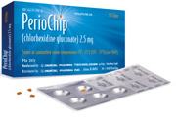


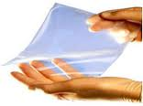
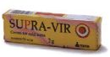
Other Products on the Market
Cationorm. The innovative cationic emulsion for the treatment of dry eye symptoms
Prof. Simon Benita
Periochip - slow drug release for periodentitis
Prof. Michael Friedman & Prof. Doron Steinberg
Bioresorbable Adhesion Barrier reduces the severity of post-operative cardiac adhesions
Prof. Daniel Cohn
Supra-Vir - Acyclovir cream for HSV topical treatment
Prof. Elka Touitou
Moisturizing Eye Drops
Prof. Shabtay Dikstein

Slide 33



Successful Start Up
 | Qlight Nanotech develops Quantum Dots - semiconductor nanocrystals that display unique optical and electrical properties. Qlight’s nanocrystals enable light conversion from UV and blue wavelengths to any other wavelength in the visible range. This guarantees high energy efficiency and cost savings for solid state lighting (LED) systems, flat panel displays and various other optical applications.
Long term collaboration with:
Inventor:
Prof. Uri Banin

Slide 34

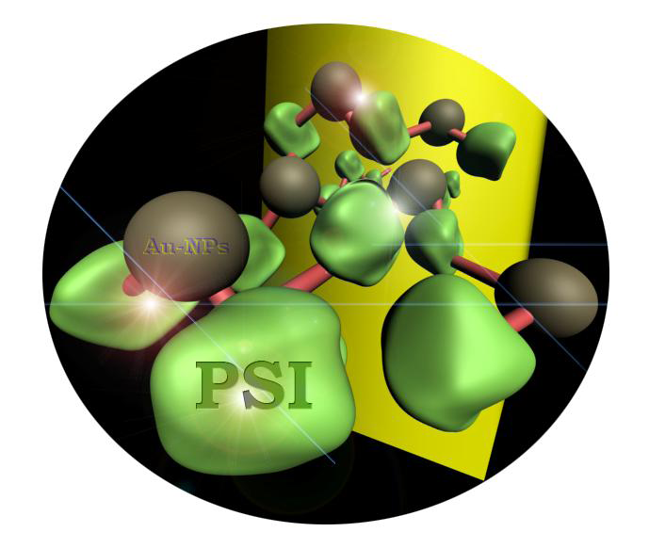
A Promising Incubator Company
Photocell : Photovoltaic Cell from Thermophilic Cyanobacteria
System that uses the natural photosynthetic light-harnessing system of cyanobacteria to convert light to electricity or fuels.
Combines nanotechnology, complex chemistry, and biotechnology to produce a functional biological molecule
Inventors:
Prof. Itamar Willner
Prof. Rachel Nechushtai

Slide 35

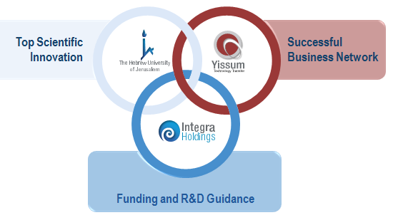






Long Term Collaboration Agreements
Integra Holdings:
The Perfect Integration
10 research projects
9 research projects
7 ongoing projects
4 ongoing projects
Integra Holdings offers attractive integration :
A strong portfolio, a future deal-flow originating from the Hebrew University and an existing strong marketing network
2 research projects
2 research projects
1 research project

Slide 36
A Proactive Approach is not Enough

Slide 37
A Necessary Shift
Patent Centered
Technology Centered
Intellectual Property
Research
Strategic Model
Licensing Agreement
Project
TT Agreements
Industrial R&D
Industrial R&D

Slide 38
Dealing with New Technologies
Meeting Yissum
Inventor
THE CLASSICAL VIEW
SO SIMPLE !!!!!!!
No
Yes
Research
Project
Institutional Evaluation
Technology Evaluation
IP Evaluation
Market Evaluation
Proof of Concept
Integration of Information
Investors and Strategic Partners
Yes
No
Business Model
Inventor/ TTO
TTO Pre-Marketing BM Implementation

Slide 39
Bridging Gaps
Invention
Actual Status
Research and License Agreement
Strategic Models
University
University
Government
Maturity for TT
Company
Industry
Government
Incubation
Interface Company
Industry
Internal Funding
Industry Funding
Other
Pre-Pre-Seed Funding

Slide 40

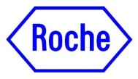



Bridging Gaps
Financial Gaps
Academic Projects/ Grants
Baby Seed
Extensive Long Term Collaboration
Kamin/
Nofar
Magneton, Incubators
Independent Companies
HUJI Projects
+ New! Collaboration with Shaare Zedek Hospital
75 projects approved for Yissum’s internal program
Funding through the Office of the Chief Scientist
Integra Holdings

Slide 41
Gracias por la Atención
Gustavo Fuchs
gustavo@yissum.co.il
gustavo.fuchs@gmail.com

