Slide 1

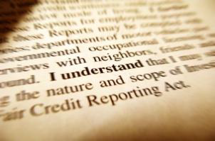
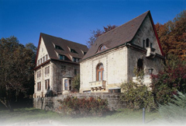
In a Nutshell:
Innovation in Baden-Württemberg
Andreas Koch
International Seminar „Knowledge and Innovation
Barcelona, October 1st, 2013

Slide 3
Four Spotlights on the Regional Innovation System
The People
The Regional Industrial Basis
Education and Learning
Cooperation and Networks

Slide 4
The People
Facts
High educational level
Challenges
Technological development / specialization needs qualified people
Answers
Further improvement of educational level
High participation in employment
Decreasing numbers of graduates
Demographic Change
Increasing the labor market participation of women
Immigration and education of immigrants
Develop the pool of qualified employment
A growing region with now nearly 11 million inhabitants
Above average life satisfaction and life expectancies

Slide 5
A Strong Regional Industrial Basis
Focus on the manufacturing sector
  Automotive industry, mechanical engineering
  Regional suppliers and knowledge intensive business services
High importance of exports
  Strong international linkages
  Vulnerability due to volatility
Regional Specialization
“Hidden Champions”
Quality and stability

Slide 6
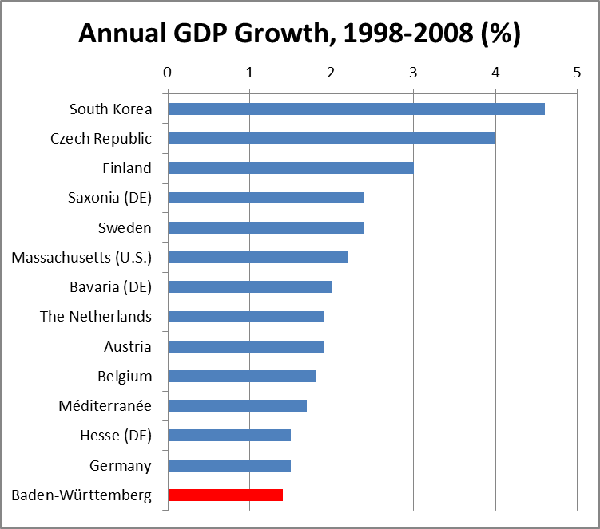
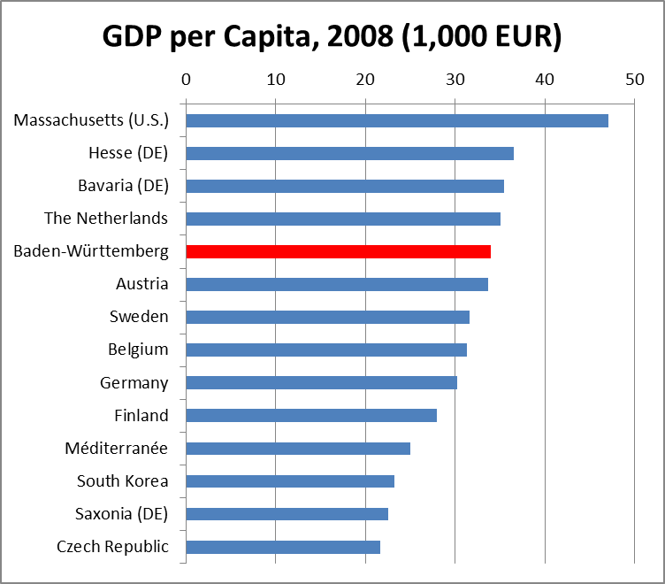
Economic Strength
and Growth

Slide 7
A diversified educational system
Cooperative Education (Duale Ausbildung) as a key feature at different levels, e.g.
  Baden-Württemberg Cooperative State University (Duale Hochschule) – integrating academic studies and work experience
Capable and productive universities, Baden-Württemberg highly successful within Excellence Initiative – Research, teaching, cooperation
Key challenges:
Transparency, connectivity and permeability

Slide 9
Cooperation and Networks
Numerous institutions promoting cooperation between core actors
Regional and sectoral clusters – promoting new technologies. E.g. recently founded regional agencies for…
  Electric mobility (www.e-mobilbw.de)
  Leightweight construction (www.leichtbau-bw.de)
Lessons to be learned
  Too many institutions?
  Border areas and interfaces between competencies
  Balance between regional focus and external linkages
  Use regional assets

Slide 10
Thank you for your attention
Dr. Andreas Koch
Institute for Applied Economic Research (IAW)
Tübingen, Germany
www.iaw.edu
andreas.koch@iaw.edu

