Slide 1


Bon dia
המינהלת הישראלית למו"פ האירופי
The Israel-Europe R&D Directorate
Your Port to R&D in ISRAEL
Marcel Shaton
Catalonia
September 2013

Slide 2
ISERD
Steering Committee:
Ministry of Economy, Ministry of Science and Technology, Ministry of Foreign Affairs, Ministry of Finance and the Council for Higher Education – Planning and Budgeting Committee.
Chairman of the Steering Committee – Mr. Avi Hasson, Chief Scientist, Ministry of Economy.
General Manager: Mr. Marcel SHATON
ISERD Aims at
Maximizing the benefits of participation in the Framework Program

Slide 3
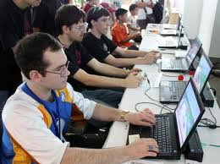
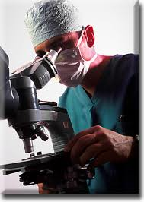

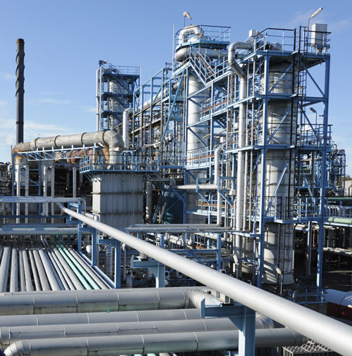

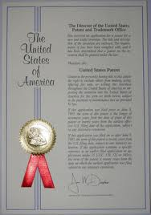
The Innovation Ecosystem
is Complex
Researchers
High skilled workers
Entrepreneurs
Funds
Research Facilities
Industry
IP Protection Laws

Slide 4
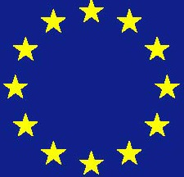
Support Programs Along the R&D Chain
Risk
Basic Research
PBC (Vatat) & ISF
Ministry of Science, Technology & Space
Other Ministries
OCS Ministry of Economy
Applies Academic Research
International
Program
EU FP
Support Policy
Research
Nofar
Tnufa
Bilateral
EUREKA
Incubators
MAGNET
Magnet
Competitive
R&D
Market Proximity

Slide 5
The OCS Programs Support
Most of these Paths
Industrial R&D
Renewable Energy
R&D Fund
Financial R&D
Bi-National Agreements
Water Technology
BioTech Fund
Nanotechnology Centers
NOFAR
MAGNET programs
Magneton
KAMIN
Technological Incubators
Young Entrepreneurs
Traditional Industry
Industrial Incubators
TNUFA
Multi-National Corporations Program
Eureka
Horizon 2020
Research Institutions
MEIMAD
TZATAM
Bio-Bank
Agriculture
NATAF
TAMIR
Large Firms Agreement
Industry-Academia Cooperation

Slide 6























R&D Centers In Israel
Over 250 foreign companies have established R&D centres in Israel

Slide 7
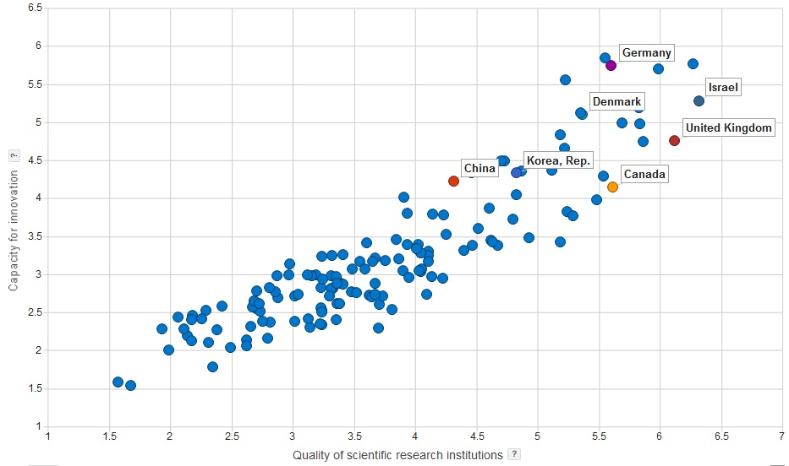
Israel is a Global Leader
in Research and Innovation
Israel
Quality of Scientific Research
Level of innovation
Source: World Economic Forum, 2011

Slide 8
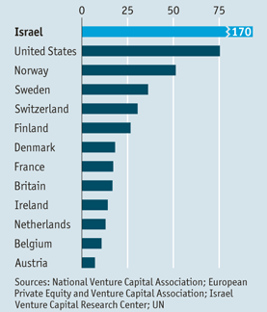
Israel’s Competitive Edge
VC Investment, $ per capita
Business Expenditure On R&D (% GDP)
1st
Total Expenditure On R&D (% GDP)
1st
Entrepreneurship
2nd
Skilled Labor
4th
Venture Capital
5th
Flexibility And Adaptability
6th
Source: IMD World Competitiveness Yearbook 2012

Slide 9
But this was not always the case…
This change was led by the hi-tech sector
~$25B: 10% of current GDP

Slide 10
Sectors of Companies in Incubators
2012

Slide 11
Government Investments VS. Private Funds Invested in Incubator Companies
(Aggregate), 1991-2011
11 | 10 | 09 | 08 | 07 | 06 | 05 | 04 | 03 | 02 | 01 | 00 | 99 | 98 | 97 | 96 | 95 | 94 | 93 | 92 | 91
Cumulative Government Investments
Cumulative Private Funds

Slide 12
Platforms for R&D cooperation
Israel - Spain
National, Regional, European:
Cooperation with CDTI and ACC1O (Catalunya).
Eureka (call will be opened this month).
Eurostars
FP

Slide 13
Funding Agencies
In CATALONIA –
Ms. Mariona Sanz Ausàs- ACCIO- Catalunya
Tel: . +34 93 4767210
E-mail: msanza@acc10.cat
In ISRAEL –
Mr. Uzi Bar-Sadeh
Tel: 03-5118185
E-mail: uzi@iserd.org.il

Slide 14
Program Characteristics
Industrial R&D in all sectors
Annual Calls for Proposals- New call is open
Joint Participation and contribution of both sides to the project
Project Financing up to 50% of Costs

Slide 15
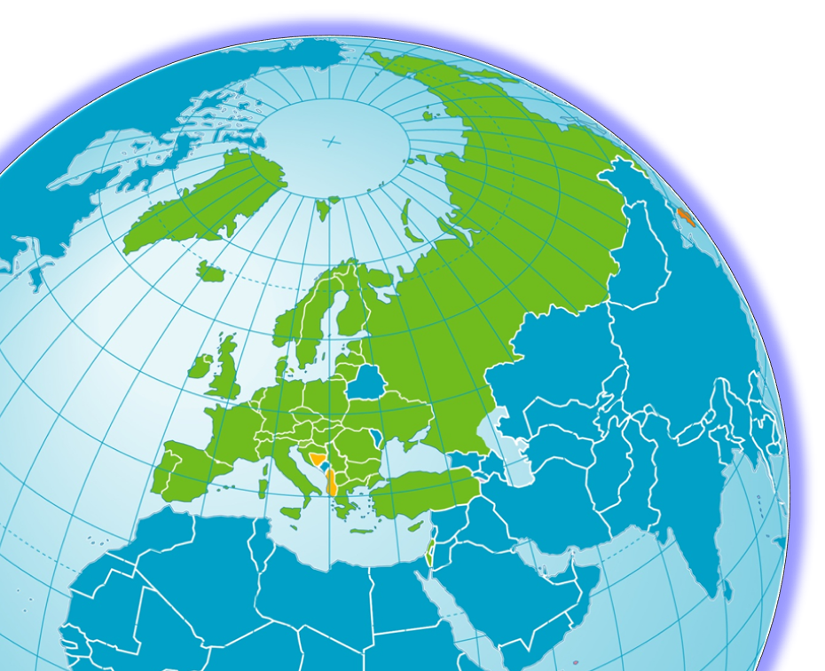
EUREKA members and affiliates
EUREKA has 41 full members; two countries with transitional status and South Korea, Canada as associate countries
Austria
Belgium
Bulgaria
Croatia
Cyprus
Czech Republic
Denmark
Estonia
European Union
Finland
France
FYR Macedonia
Germany
Greece
Hungary
Iceland
Ireland
Israel
Italy
Latvia
Lithuania
Luxembourg
Malta
Monaco
Montenegro
The Netherlands
Norway
Poland
Portugal
Romania
Russian Federation
San Marino
Serbia
Slovakia
Slovenia
Spain
Sweden
Switzerland
Turkey
Ukraine
United Kingdom
Transitional status:
Albania
Bosnia-Herzegovina
Associate country:
South Korea
Canada

Slide 16

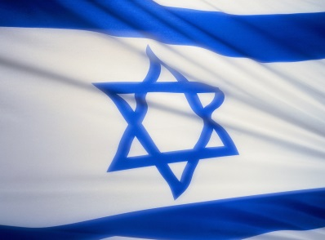
Israel is an Associated State
that allows it full participation in the
Framework RTD Programs since 1996
(mid FP4)

Slide 17
Why Israel participates in the
Framework Programmes
Integration of Israeli market in globalization process
Increase Israeli business penetration in Europe
Increase visibility of Israeli academic community in Europe
Enhance cooperation between industry and academia in Israel

Slide 18
Benefits of participation
Access to new technology/techniques
Access to new markets/key customers
Better sector knowledge
Involvement in new standards
Playing in the major leagues
Funding

Slide 19
Added Value for a Company
Participating in FP7
Strategic partnerships
Synergy of resources
Market intelligence
Access to research of the entire project
Shorter time to market
Name recognition
Standardization
Funding for large R&D projects
Integration in the European market

Slide 20

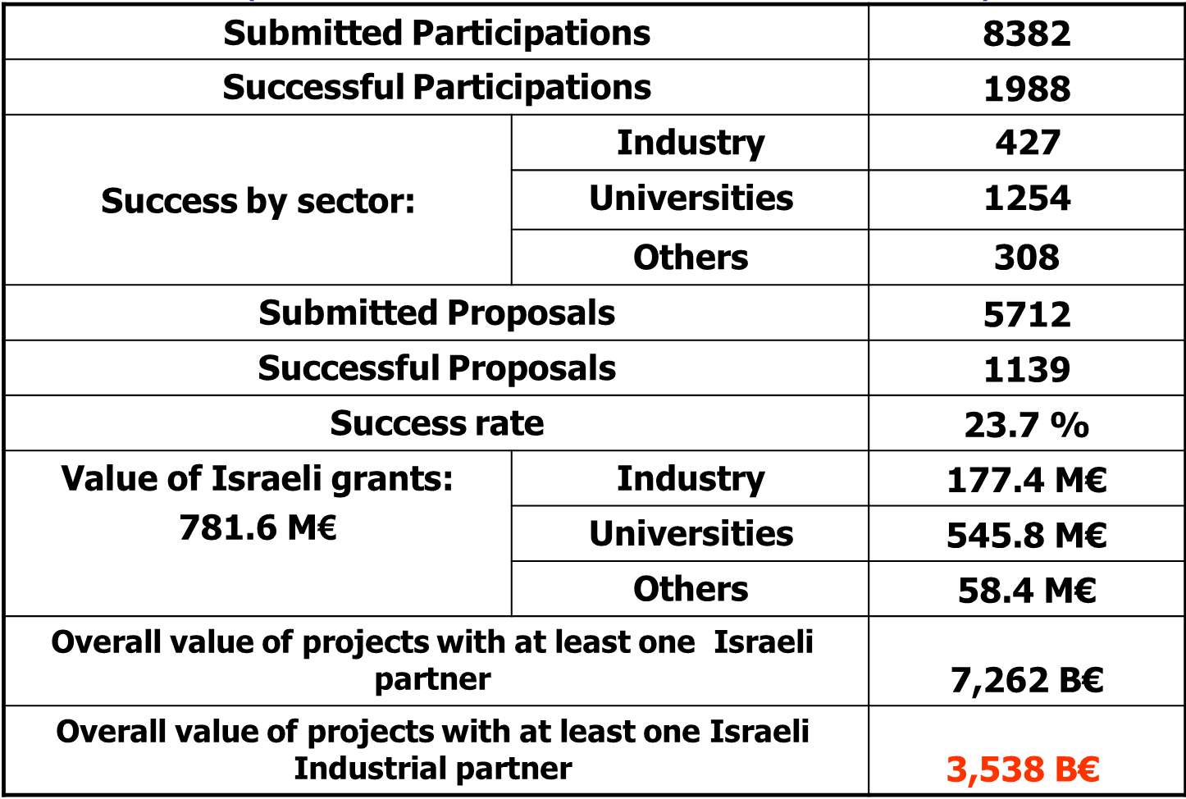
The Israeli Results in FP - September 2013
( Israeli total contribution to FP7: 535 M€ )

Slide 21
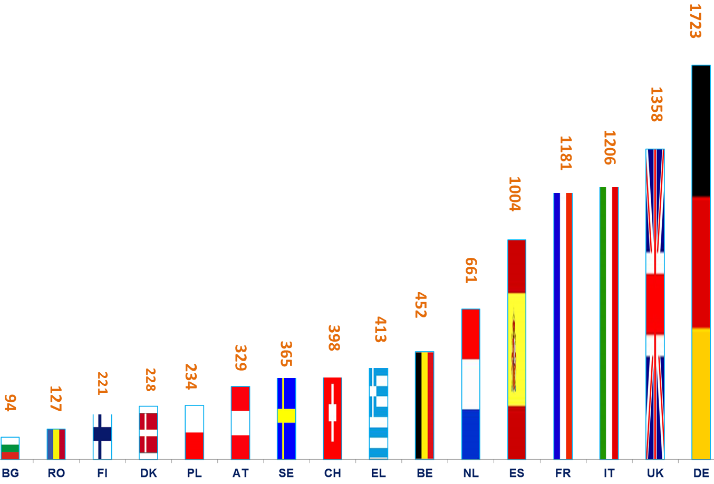
Israeli Cooperation with
EU Partner-Countries
in Approved FP7 Projects
source - EU E-corda - June 2013
source - EU E-corda - March 2013

Slide 22
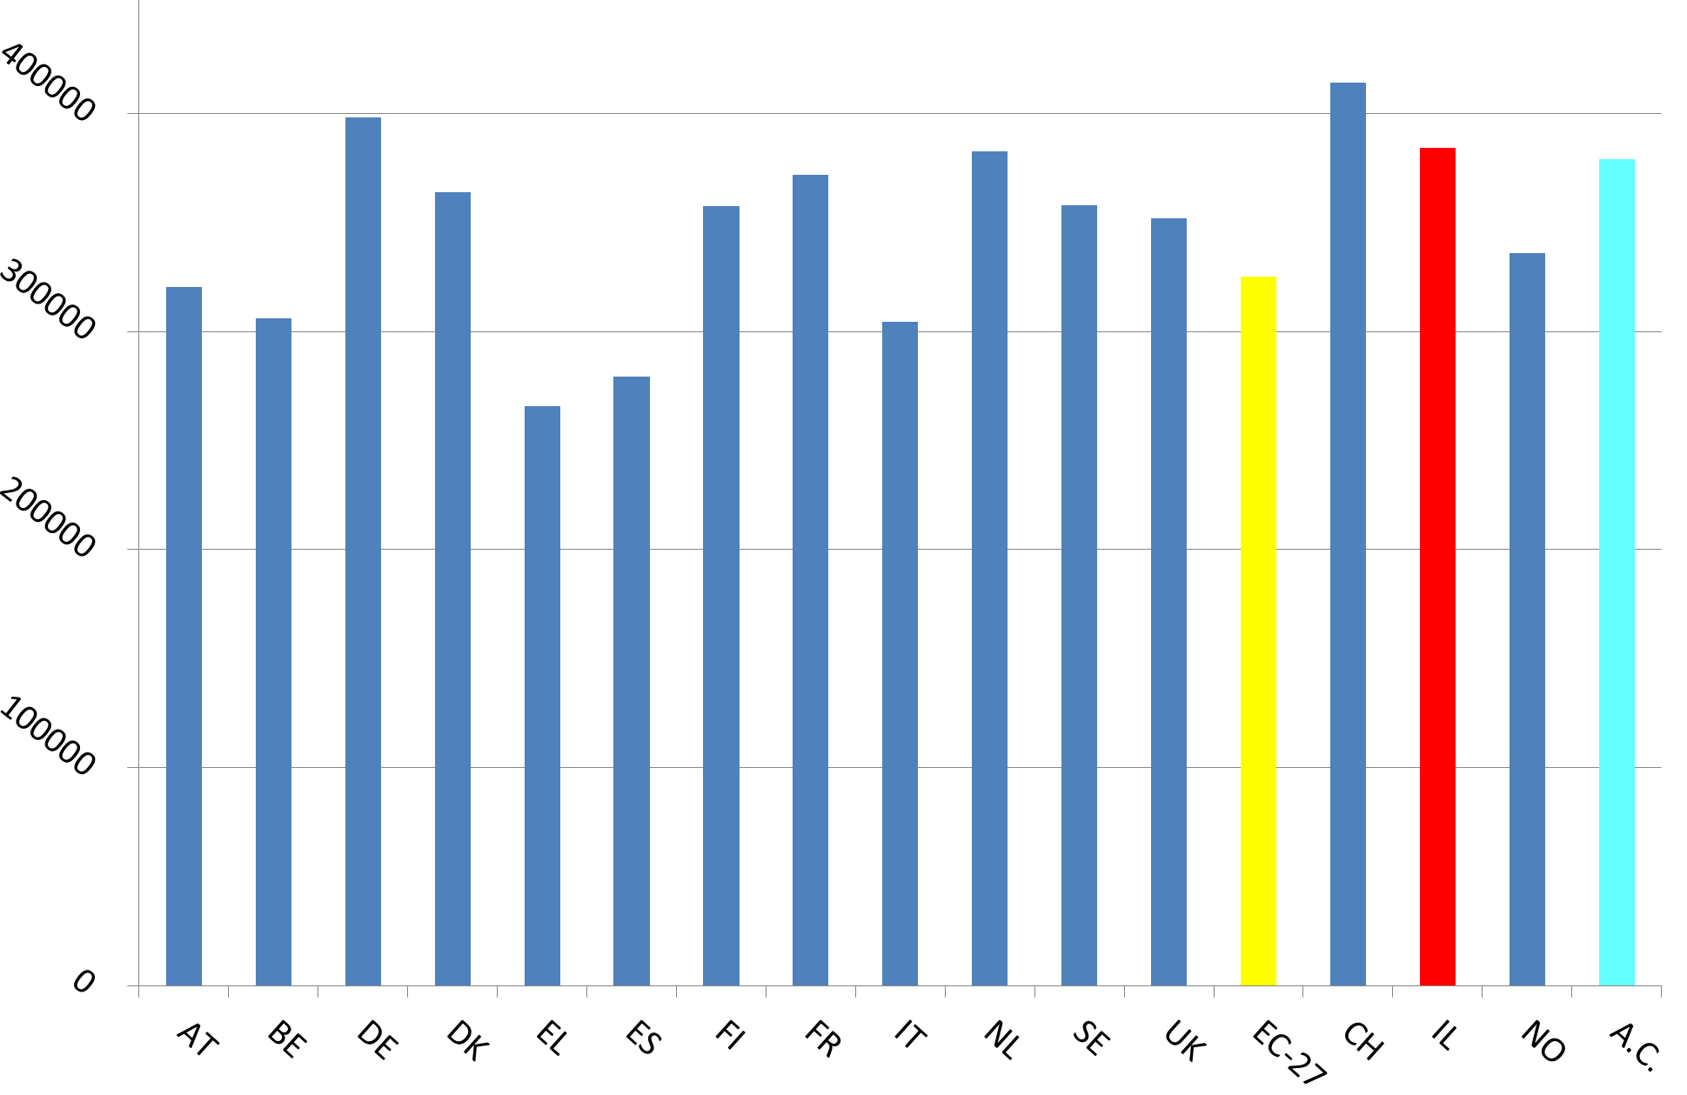
Average Grant by country Per-Capita
in FP7 Approved Projects
source - EU E-corda - June 2013

Slide 23
CATALONIA - ISRAEL
Cooperation in FP7 Approved Projects
Research Themes | Projects | Participants
 |  | Catalonia | Israel
Health | 25 | 31 | 35
Food, Agriculture, Biotechnology & Fisheries (KBBE) | 8 | 13 | 8
Information & Communication Technologies (ICT) | 27 | 38 | 36
Nanotechnologies, Materials, Production (NMP) | 10 | 12 | 16
Energy | 5 | 8 | 11
Environment | 7 | 10 | 9
Transport & Aeronautics | 3 | 4 | 3
Space | 3 | 4 | 3
Security | 3 | 4 | 6
Socio-Economic Sciences & Humanities (SSH) | 5 | 11 | 5
PEOPLE | 5 | 4 | 6
Research Infrastructures (RI) | 11 | 11 | 13
SME (Small & Medium size Enterprises) | 5 | 7 | 7
Research Potential (REGPOT)
Science in Society (SIS) | 4 | 4 | 4
INCO
Total | 121 | 161 | 162
source - EU E-corda - June 2013

Slide 24
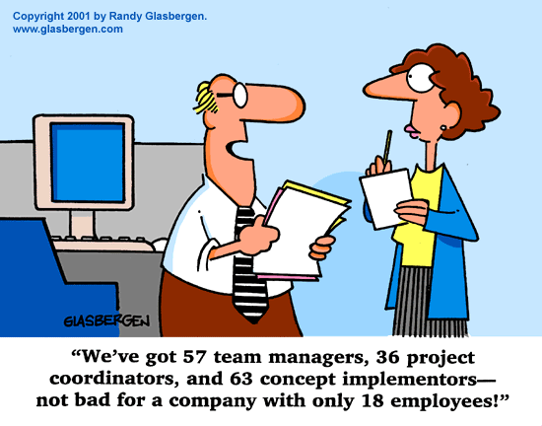
Moltes Gràcies

