Slide 1
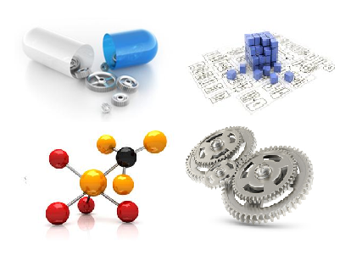
Some Observations on The Israeli Knowledge Commercialization Model
David Mendlovic
Faculty of Engineering, Tel Aviv University

Slide 2
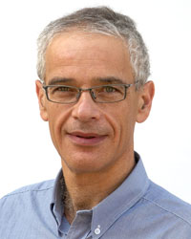



David Mendlovic (PhD) – Short Curriculum Vitae
B.Sc. and Ph.D. degrees in EE from Tel Aviv University, Israel
Erlangen University, Germany as a MINERVA postdoctoral fellow
Full Professor of electro-optics with Tel-Aviv University
More than 200 technical articles, 2 books, 3 book chapters, and more than 40 patents all of them have been commercialized
The 1998 winner of the ICO (International Commission of Optics) Award
Few patents became worldwide technology standards
Founder of successful opto-electronics startup companies (e.g. ,
) , ) and served as their CEO
2008 - 2010: Chief Scientist of the Israeli Ministry of Science and Technology
Co-Chairman of the German – Israeli Foundation (GIF)
Chairman of the Industrial Affiliates Program (IAP) of TAU Faculty of Engineering

Slide 3
Agenda
R&D in Israel:
  National level – My Ministry of Science and Technology experience
  University level – Tel Aviv University and RAMOT
  Faculty level – IAP
My personal experience:
  Licensing by the University
  Founding a company with the University
  Activity which is not connected with the University

Slide 4

R&D In Israel:
National level – My Ministry of Science and Technology experience

Slide 5
Israel As a Scientific Leader
Scientific Publications – Israel is one of the two world wide leader in scientific publications per capita – 1% of the scientific worldwide publications, 2% in mathematics
Scientific Citations – Israel is the 3rd worldwide leader in citations per capita. In 6 over 20 scientific fields, Israel is number 1
Scientists Per Capita – 0.5% of the overall population. Israel is number 1 with 133 scientists per 10,000 employees
Investment Is Science – Israel invests more than 4% of the Gross National Product (#1), more than Finland and Sweden (3.3%)
5 Israeli Nobel Prize winners in the last decade

Slide 6
Bridging the “Development Gap”
“Development Gap”
Academia
Industry
Science
Products

Slide 7
Research in Israel – Mind The Gap
Directed R&D
BASIC
RESEARCH
Several funding resources mainly in Universities and research institutes
STRATEGIC
RESEARCH
The well known “Gray Zone”
APPLIED
RESEARCH
Min. of Economy and
Commercial companies
"Strategic Research - the Connecting Link"

Slide 8
The Dilemma of Directed Research
Free R&D
Maximizes the creativity
Keeps academic freedom
Enables dealing with more fields
Directed R&D
Better use of the national resources
Adequate to a small nation
Creates critical mass
Influencing the R&D fields via INFRASTRUCTURES (manpower & equipment)

Slide 9
Strategic Planning NCRD
Definition of National R&D Strategy
Recommendations
and Implementations
Study
SWOT of the Israeli R&D
Studying the various R&D organizations and their contribution
Studying the academy-industry interface
Establishing information data base of scientific connections
Comparison of Israeli R&D to other developed countries
Locating & updating the information of the binational and multinational R&D agreements
Analyzing the SWOT
Define long term national R&D strategy
National level discussions regarding priorities
Propose academy-industry interface and IP handling
Implementation of long term national priorities
Recommend structural changes for improving the R&D in Israel
Budgetary recommendations
Operational recommendations to the various R&D organizations

Slide 10
Examples
Nano technology
Alternative energy
Bio information
Gene cell therapy
Stem cells
Telecommunication

Slide 11
R&D Value Chain
Where?
Basic Research
(ISF, BSF, GIF,…)
Academy
Ministry of Science
Academy
Academy/Industry
Ministry of Economy
VCs and other investment funds
Industry
Market penetration & creation of value
Industry

Slide 12
Pie Of Governmental R&D Investment

Slide 13
R&D In Israel:
University level – Tel Aviv University and RAMOT

Slide 14
TEL AVIV UNIVERSITY
From Discovery to Commercialization

Slide 15

TAU PROVEN INNOVATION ENGINE
>$150,000,000
ANNUAL INVESTMENT in R&D

Slide 16


TAU PROVEN INNOVATION ENGINE
1,800
RESEARCH PROJECTS
ANY GIVEN TIME!

Slide 17


TAU PROVEN INNOVATION ENGINE
588
>50%
ACTIVE PATENT FAMILIES
IN THE PAST 5 YEARS
30%
ALREADY LICENSED
~40
NEW ISRAELI COMPANIES

Slide 18

TAU PROVEN INNOVATION ENGINE
Ranked14th in the world in scientific citations (right below MIT)

Slide 19
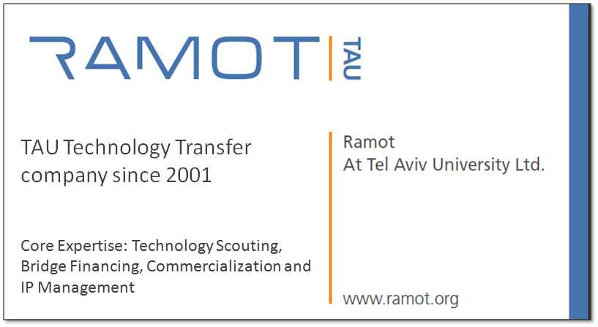
RAMOT
Ramot is a leading technology transfer company committed to transforming Tel Aviv University (TAU) technologies into products having a positive impact on society.

Slide 20
Technology Transfer
University-industry technology transfer is the process of moving research results from the laboratory to the marketplace
Notes:
Excerpted from: “Technology Transfer from U.S Universities — A Major Driving Force of U.S. Prosperous Economy,” presented by Terry Young, Texas A&M University System Technology Licensing Office.

Slide 21
Technology Transfer Process
2-3 Years
10 Years
Research
Innovation
Discovery
Business
Development
Licensing
Contract
Management &
Enforcement
Development
Patenting
Evaluation
Marketing
Research
Revenues
Research
Enterprise

Slide 22
Deal Models and Revenue Strategies
Research and Development Agreements
Funded by companies, Israeli government
Licensing Deals
Licensing of IP, know how to an existing company
New venture formation / Spin-offs
Licensing of IP to the start-up company
TAU holds IP
Fees and Milestones payments
Running Royalties
Equity participation
40% TAU
40% Inventors
20% Further research

Slide 23

PROVEN TRACK RECORD
High quality of research
& successful commercialization

Slide 24




































SELECTED PATRNERS

Slide 25




Slide 26
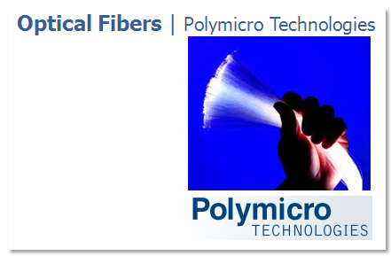



Slide 27
Technology Transfer Process
2-3 Years
10 Years
Research
Innovation
Discovery
Business
Development
Licensing
Contract
Management &
Enforcement
Development
Patenting
Evaluation
Marketing
Research
Revenues
Research
Enterprise

Slide 28


Bringing Ideas to Life and Accelerating Israeli Innovation
TEL AVIV UNIVERSITY
Technology Innovation Momentum Fund
suggested funding model

Slide 29

STRATEGY AND STRUCTURE
Raises $20 million in committed capital
Managed by Ramot, on behalf of the Partnership, the dedicated business development and technology transfer arm of TAU
No management fees will be charged.
All revenues from licensing / commercialization activities will be allocated between TAU and the LP’s
Targeted annual IRR > 10%!; Life expectancy >15 years
An Israeli sister-company is created by Ramot to serve as the General Partner of the Momentum Fund

Slide 30
R&D In Israel:
  Faculty level – IAP

Slide 31
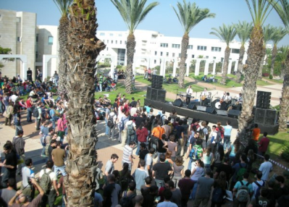

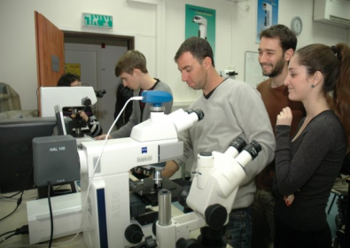
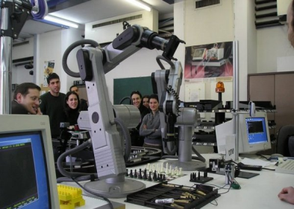
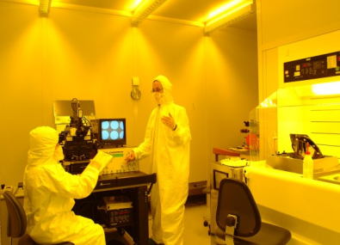
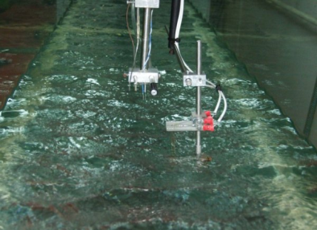
Industrial Affiliates Program
The Iby and Aladar Fleischman Faculty of Engineering
For more info, please contact us at industry@tauex.tau.ac.il

Slide 32
Faculty of Engineering: Facts
Dean of Faculty
Admin
Biomedical Engineering
Industrial Engineering
Systems
Physical Electronics
Mechanical Engineering
Electrical Engineering
Material Engineering
101 Faculty members
2200 undergraduate students
1000 graduate students
Research institutes:
  The Max and Betty Kranzberg Institute for Electronic Devices
  The Wolfson Applied Materials Research Center
  The micro & Nano Fabrication Facility (TAU-MNF)
  Advanced Communication Center (ACC)
  The Yitzhak and Chaya Weinstein Research Institute for Signal Processing
  The Stephan Meadow Fund for Experimental Aerodynamics
  The Gordon Center for Energy Studies
  The Ela Kodesz Institute for Cardiac Physical Sciences and Eng.
  The Nicholas and Elizabeth Sleazak Super Center for Cardiac Research and Medical Engineering
  The Bertold and Sonia Badler Research Fund for Technological Development in Cardiology
  The Tamara Glanz Research Fund in Visual Technology
  The Harold Tanenbaum Fund in Biomedical Engineering

Slide 33
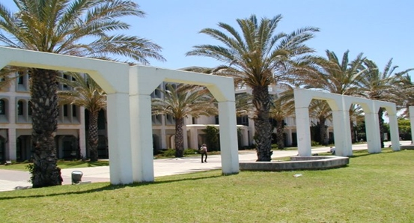
Faculty of Engineering: In General
Founded 1971
High-tech oriented, to participate in Israel’s economy and industry
Under graduate studies:
  Comprehensive and basic training in the modern engineering foundations
  Emphasis on Israel’s special needs.
Graduate studies:
  Expands B.Sc. knowledge
  Specialize in applied and basic research.

Slide 34

IAP: Vision and Mission
Vision
Collaborative partnership for competitive advantage:
Academia and Industry Working Together!
Mission
  Promote, facilitate, and enhance dialogue and cooperation between the Faculty of Engineering and industrial peers, to stimulate and generate progress in both sectors
  Provide a platform for industrial peers to engage with the Faculty in research, development, knowledge transfer, academic curriculum and talent recruitment
  Activate knowledge transfer (by )

Slide 35

Industry – Academy Partnership
Outstanding Research
Relevant
Academic Freedom
Products
IP
Implementation Tools
Mutual Research
Ramot
Excellent
HR
Know How
Visibility
Flexibility

Slide 36

IAP Program Benefits
Research and Development
Visibility
Education
Recruiting
Involvement in Faculty agenda
Industrial Services

Slide 37
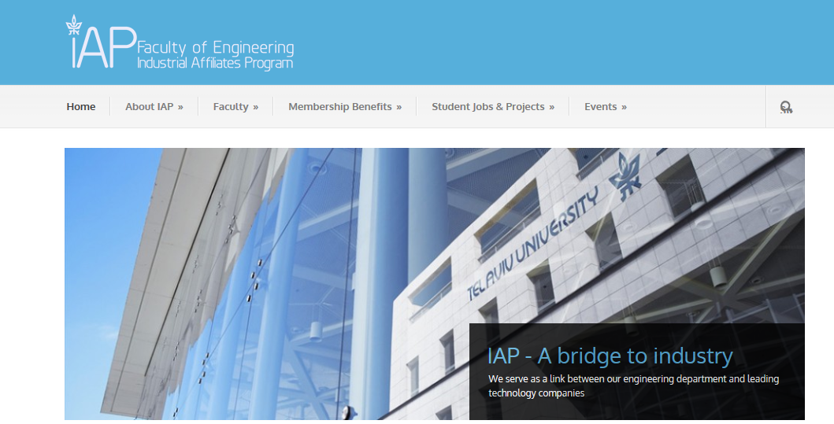

Slide 38
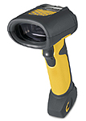
My personal experience:
  Licensing by the University
  Advanced Barcode Scanner

Slide 39
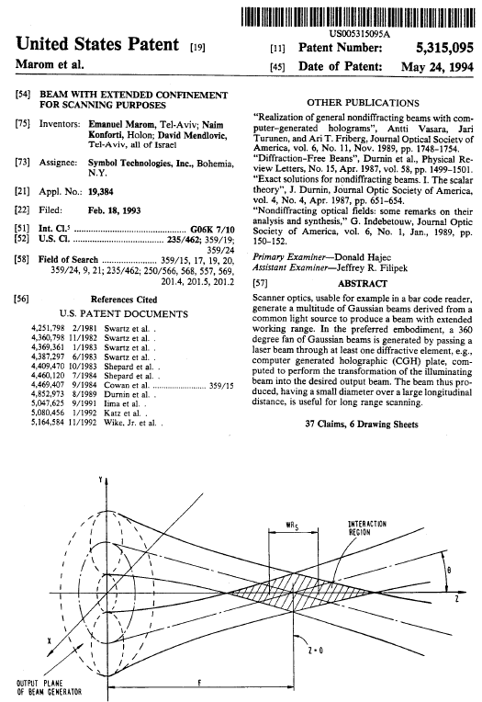
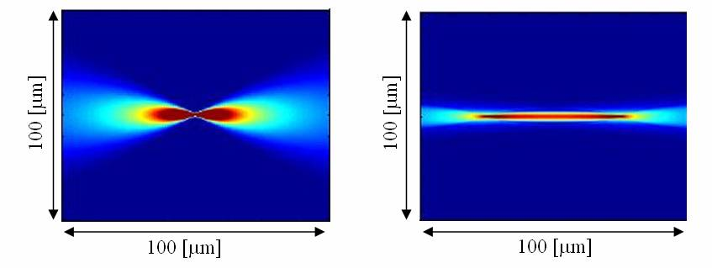
As part of my PhD activity, a patent for forming a beam with extended confinement was applied and approved
The patent was engineered to a product in the lab based on NRE payment from Symbol and later approved by Symbol
RAMOT owns the patent

Slide 40





The Unfair Advantage
Resolution (MIL) | LS-3408 FZ | LS-3408 ER TAU Technology
7.5 | 13” | 20”
20 | 27” | 94”
55 | 84” | 180”
70 | Cannot scan | 365”
100 | Cannot scan | 540”

Slide 41


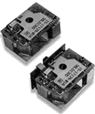

Licensing By RAMOT
Symbol signed a licensing agreement with Ramot for using the know how and the patent
Symbol is the world wide leader in barcode scanner
Symbol integrated the technology in most of its products – Approx. 650,000 devices per year
Motorola acquired Symbol while ago

Slide 42
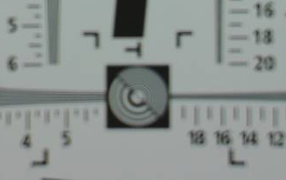
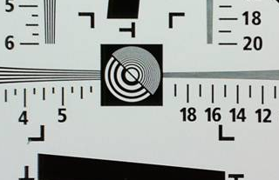
My personal experience:
  Founding a company with the University I
  Seeing Beyond The Limits

Slide 43
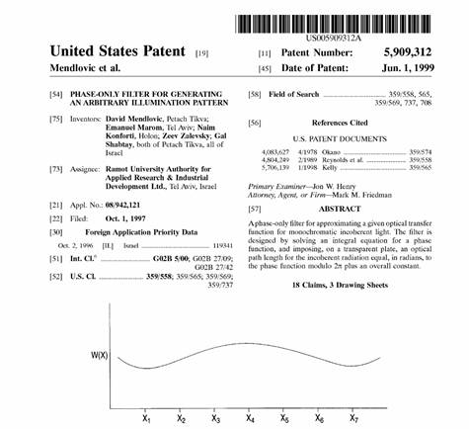
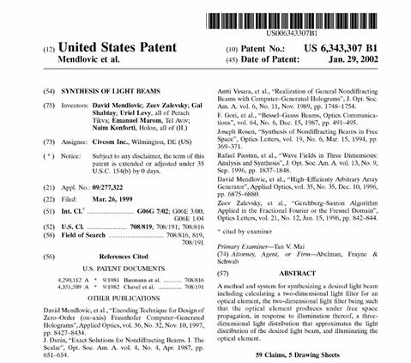

Together with my PhD student Gal Shabtay we developed a proven technology for digital auto focus
RAMOT applied 2 patents
The patents were assigned to a new startup that I founded with Gal
RAMOT hold a certain stack in Eyesquad
TAU approved me on-leave vacation for serving as the CEO of the company
After a year acquired
RAMOT liquidized its shares in the company

Slide 44
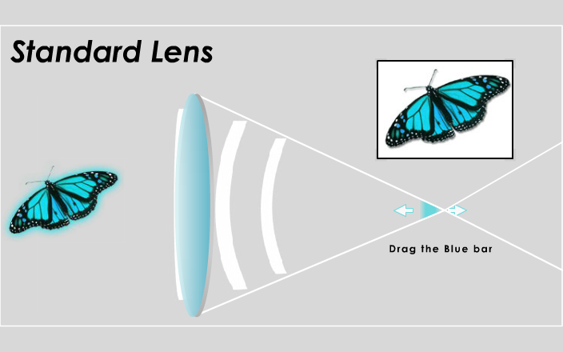
מצלמה סטנדרטית

Slide 45
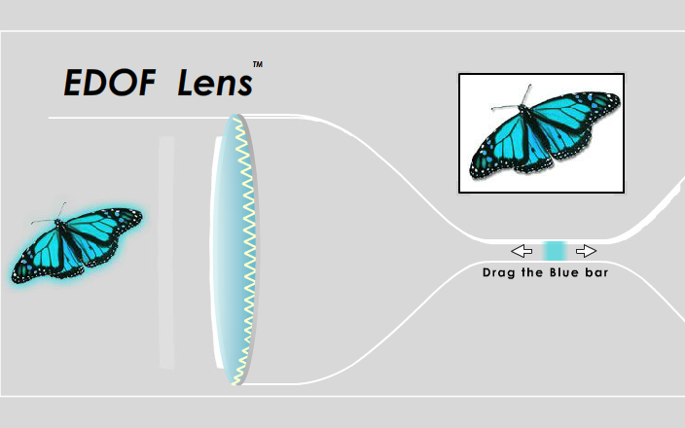
מצלמה Auto-Focus

Slide 46
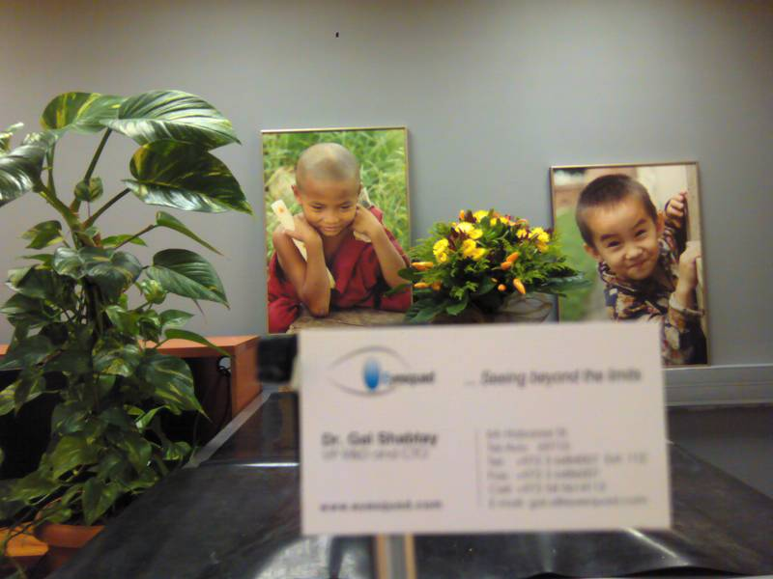
3m
1.5m
20cm

Slide 47

3m
1.5m
20cm

Slide 48


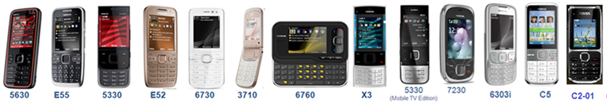
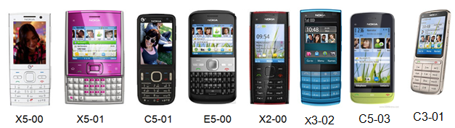
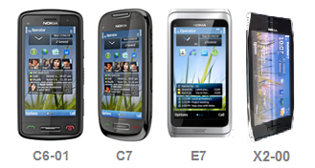
  3MP - 30 Handsets: 240M Units
  5MP – 25 Handsets: 260M Units
  8MP - 4 Handsets: 30M Units

Slide 49

My personal experience:
  Founding a company with the University II
  Enlightening Solutions

Slide 50

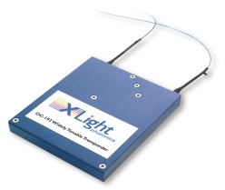





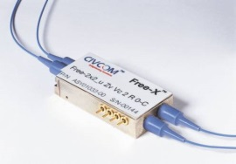
Value Chain
Transponder
OpNext
JDSU Vitesse
Triquint
OCP
Intel
Kodeos
Module
Agility
Santur
Bookham
Iolon
Princeton Optronics
BW9
Free-Light FL-TT-10G
Temperature tuning DFB lasers
DBR
DFB lasers
Laser
Fixed
Narrow
Wide
Tunability

Slide 51

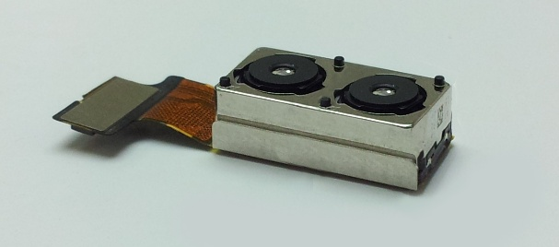
My personal experience:
  Activity which is not connected with the University

Slide 52

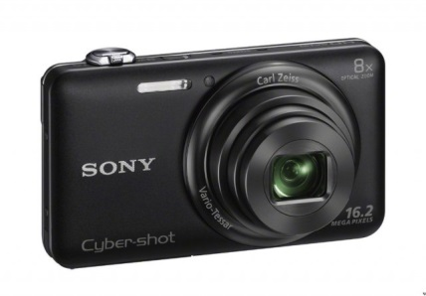

While serving as a Chief Scientist, the engagement with TAU was freeze (to avoid conflict of interests)
I gathered the former Eyesquad team and founded Corephotonics
TAU has no claims to Corephotonics
The Vision - Enable DSC performance in smartphones with affordable solutions
< 6mm thick

Slide 53
Thank You
Contact Information:
Prof. David Mendlovic, Chairman of IAP
Tel: +972-3-6408245 | Cel: +972-54-5614101 | Email: mendd@post.tau.ac.il

