Slide 1
Funding models of European universities
ACUP Seminar
Barcelona, 13 June 2012
Maria Helena Nazaré
President of the European University Association

Slide 2
Funding Trends
Modes of Public Funding
Public Funding Modalities
Formulae
Challenges
Conclusions

Slide 3
Funding Trends: state of play
On average, almost ¾ of universities’ funding comes from
national/regional public funding sources
Notes:
Private funding: Student financial contributions
Diverse sample from the EUDIS study (well over 100 European universities) shows that majority of funding for universities comes from public sources.
9% average figure includes diverse universities, with universities not allowed to charge fees and universities receiving more than 25% of their income from student fees
Tuition and administrative fees
International students: fees collected from non-EU students represent generally less than 10% of the fees collected (exception of England – up to 1/3 or even ½ of collected fees)
Potential as an income source but ambiguous funding stream (indirect support from public authorities)
Income from Business, philantropic funding and service related income differs between different instituions – some can have quite a high percenatge.

Slide 4
Changing modes of public funding
More Competitive funding
    Success rate may even be criterion for general funding formula
    Requires universities to invest in their support capacities
    Often includes co-funding requirements
More Targeted funding
    Some authorities tend to cut in block grants and re-introduce targeted funding geared towards the achievement of specific objectives => restricts autonomy (?)
Increased use of output criteria
    Influences university’s strategic choices
    Impact on autonomy
Performance-based funding mechanisms
    Increased administrative procedures for universities and funders

Slide 5
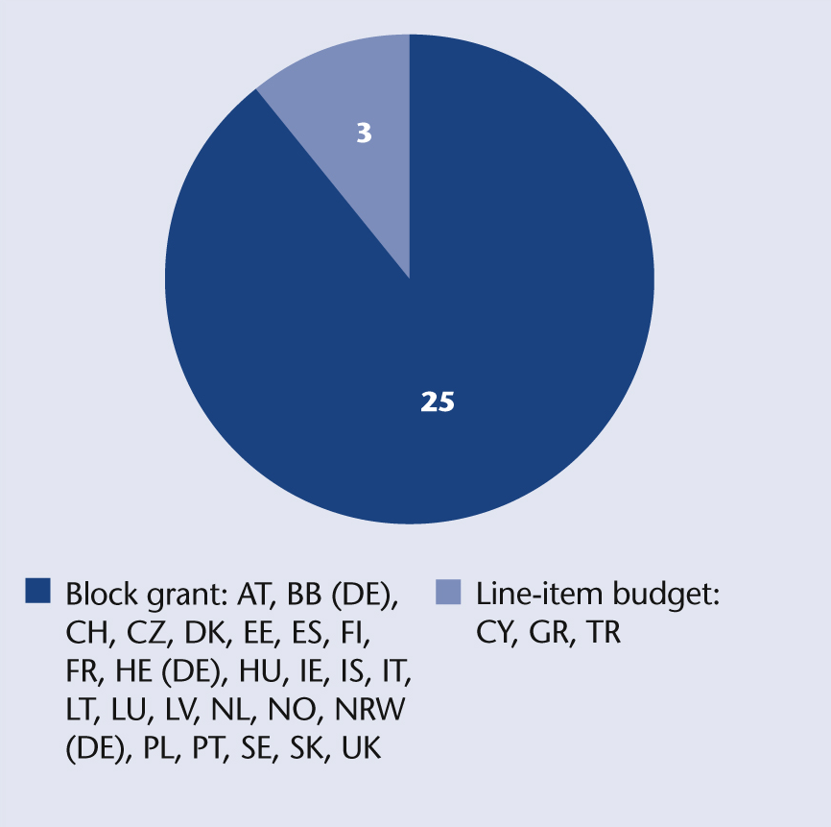
Modalities of public funding
Notes:
The majority of systems in Europe distribute funding to universities through block grants. Only three countries still use line-item budgets.

Slide 6
Restrictions on allocation of block grants
Block grant is split into broad categories and there are no or limited possibilities for moving funds between these
Internal allocation possibilities for block grant are limited by law
Other restrictions, such as earmarking of a certain percentage or the setting of target agreements

Slide 7
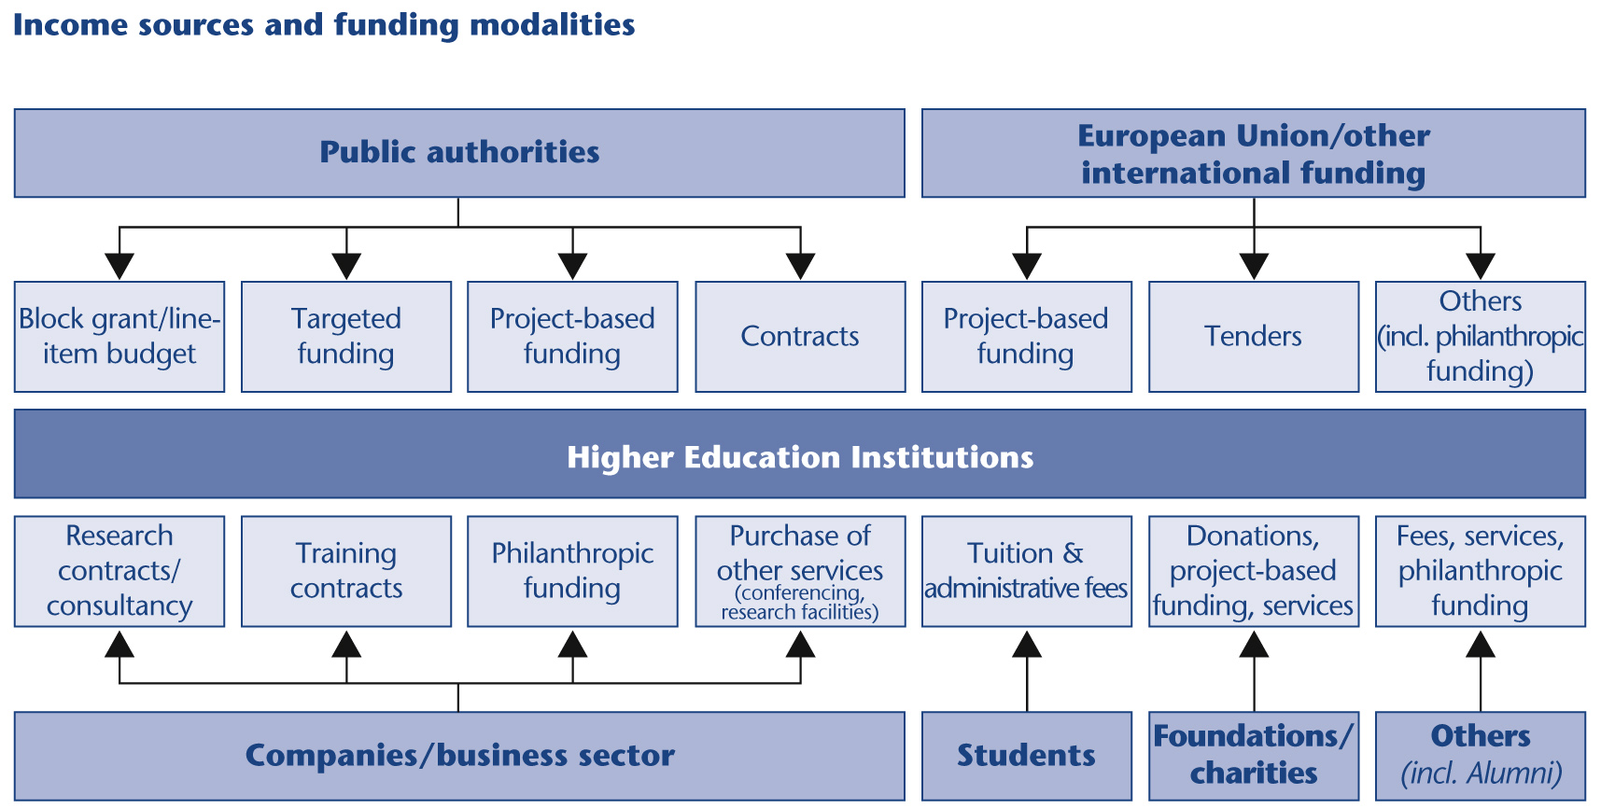
Income sources
Notes:
A simplified picture of the variety of funding sources and the way they can arrive at the institution. Many european universities have to deal with well over 100 different sources with often very different accountability regimes (sometimes differenig although coming from the same funder).
This illustrates the complex funding situatuion that universities have to deal with.

Slide 8
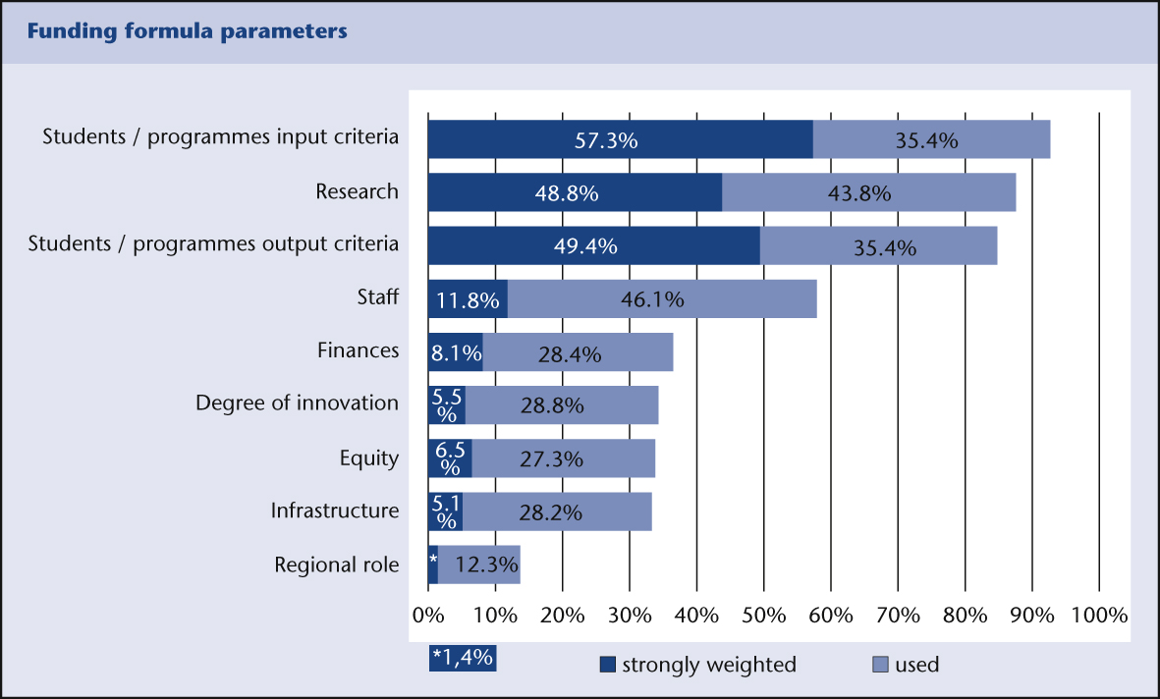
What do funding formulae take into account?
Notes:
This comes from the EUDIS study. A survey was conducted in 2009 to which over 100 European universities responded.
It can be read as follows:
In almost all cases, input criteria related to student numbers/programmes are used in the funding formula, whether it is strongly weighted or only “used”.
Research is the next item, also very frequently used.
Items related to staff, finances, innovation, equity, infrastructure or the regional role of the university are less frequently used, and are often secondary types of criteria (not strongly weighted).
However there are indications that this is changing in several European countries that are currently reviewing their funding allocation systems, and there is a drive towards the more frequent or stronger inclusion of output-related criteria.

Slide 9
Funding challenge:
Increasing co-funding
Does not cover the full costs of an activity (especially indirect costs)
Becomes a regular challenge for universities:
  a majority of universities deal with co-funding for part of their national/regional public funding, in addition to contracts with the private sector and Euroepan funding.
  Universities with more diversified funding structures also have to deal in a more systematic way with co-funding requirements.
Is associated to competitive funding schemes, which public authorities increasingly resort to.
Widens the FUNDING GAP!!
Leads to underinvestment in infrastructure and Human resources

Slide 10
Key messages: what can authorities do?
    Improve framework conditions – increase financial autonomy and adopt funding based on full costs of activities
    Adopt an appropriate mix of funding modalities – consider the impact of different modes of funding (competitive funding, targeted funding) on universities and the HE system in general
    Strike the right balance in terms of accountability – strive to simplify funding modalities & relieve administrative burden
Implement smart funding incentives – including matched funding schemes to encourage private funding in HE
Support leadership development & professionalisation of management

Slide 11
THANK YOU!
For more information on EUA’s work on funding,
please contact:
funding@eua.be
Or visit:
www.eua.be

