Slide 1
Higher Education Funding
Mechanisms in Germany
Prof. Dr. Frank Ziegele | University Funding Seminar
Barcelona, June 13, 2012

Slide 2
Agenda
The context
Outlines of the funding system
Mechanisms of state funding
Some figures on funding
Lessons learnt

Slide 3
The German funding model is of course not independent from (political) contexts.
federal system, state responsibility, 16 systems
change in steering paradigms: new public management
specific roles of federal government:
projects of national relevance, student support
specific demographic development
political objectives: research excellence
strong non-university research sector
Universities and Fachhochschulen (universities of applied sciences)

Slide 4
Agenda
The context
Outlines of the funding system
Mechanisms of state funding
Some figures on funding
Lessons learnt

Slide 5
Public funding models in Germany try to balance three major purposes.
guarantee basic funding, stability, autonomy, multi-period planning horizons
create competition, ex post rewards/sanctions, performance orientation
BALANCE
induce targeted incentives, promote strategies/profiles, ex ante funding of innovations + excellence

Slide 6
The balancing in a federal system leads to complexity of public funding sources.
Federal government (3 billion €)
focus
16 state governments (20 billion €)
higher
education
pact
research
project
funding,
DFG 20% overhead
institutional funding
project
funding
matching funds federal programs
excellence initiative research
competitive targeted funding (e.g. teaching quality)
Deutsche Forschungs-gemeinschaft
(DFG)
research
project
funding
higher education institutions

Slide 7
The excellence initiative leads to focused investment in world-class research (peer- review based).
graduate schools
research clusters
future excellence plans of institutions
qualifies
collaboration (incl. non-university research)
international competitiveness
interdisci-plinary cooperation
all fields
young +
world-class researchers involved

Slide 8
The Higher Education Pact leads to a nation-wide „money follow student“ funding element.
background: „student high“ (demographics, participation)
additional students compared with 2005 (plan: 91.000 until 2010)
allocation: planned expansion (ex ante) + real student numbers (ex post)
→ political decisions + real performance
„quick money“ leads to flexibility, very effective
(in fact 182.000 additional students until 2010)
limited to bachelor level, master level neglected
(short-sighted policy)

Slide 9
The state institutional funding models are diverse, but with some common ground.
framework contract
financial model
Deregu-
lation
university
expenditures:
lump-sum
budgeting
univ. revenues:
goal-oriented
funding,
„3-pillars-model“
state
objectives
accountability, KPI

Slide 10
The 3-pillar model is more or less implemented in all German states.
ratio-
nale
cost orientation
ability to fulfill tasks
stability
stable planning horizon
steering objectives
influence behavior
incentives for
performance
rewards for past
performance
finance innovation in
advance
control result of
innovation
promises on future
performance
basic, task-
oriented funding
performance-
oriented funding
innovation-
oriented funding
3 pillars
+
+
differences in weights, instruments used,…
(identification of 3 types in Germany)

Slide 11
Agenda
The context
Outlines of the funding system
Mechanisms of state funding
Some figures on funding
Lessons learnt

Slide 12
The three-pillar-model exists more or less in all the states, but with differences. Type 1 combines „history“ + performance.
basic
funding
performance-
oriented
funding
innovation-
oriented
funding
+
+
historical budget
staff-oriented
will change if staff plan
changes
sometimes „general deal“
(lump sum + strategies/
targets in a general contract)
substantial element
of formula funding
specific programs

Slide 13
A good example for type 1 is
Lower Saxony.
basic funding (with „general deal“ contract, list of topics to be covered)
some innovation programs (small budgets, for instance family orientation, humanities program, internationalization program – competitive funds)
performance budget (formula with indicators, 10 %)
task | indicator | share
Teaching 48 % | first semester students | 21 %
 | graduates (weighted according to study duration) | 75 %
 | incoming students | 2 %
 | outgoing students | 2 %
Research 48 % | research income | 74 %
 | Ph.Ds | 24 %
 | Humboldt stipends | 2 %
Gender equality 4 % | newly appointed female profs | 40 %
 | female graduates | 20 %
 | female Ph.Ds | 20 %
typical set
of indicators

Slide 14
The size of the performance-oriented pillar varies between the states.
> 20 %: Berlin, Rhineland-Palatinate, Thuringia
0 %: Bremen, Saxony-Anhalt, Saarland
3 states
3 states
3 states
7 states
5-20 %: Hamburg, Baden-Württemberg, Brandenburg, Hesse, Mecklenburg-Western Pomerania, Lower Saxony, North Rhine-Westphalia
0-5 %: Bavaria, Saxony, Schleswig-Holstein

Slide 15
Type 2 is an indicator-dominated model with basic formula funding.
number of students or professors
field-specific price per student/professor
research included in price
students vs. professors: balance between
supply- and demand-orientation
mechanisms of stabilization (loss caps,
multi-year averages)
often integrated model for universities and Fachhochschulen
basic funding

Slide 16
A good example for type 2 is Berlin.
comprehensive price model: integrated model for demand-oriented
basic funding and performance-orientation
basic funding price, examples (€) (31 %) | humanities (university), per student | 13.000
 | engineering (university), per student | 24.000
 | engineering (FH), per student | 18.000
 | arts (university), per student | 43.000
research rewards, examples (€) (31 %) | third-party-funding (per 1.000 €) | 500
 | participation graduate school (per school) | 300.000
 | Ph.Ds (university) | 25.000
 | regional cooperation contracts (FH) | 25.000
gender/ diversity rewards, examples (€) (4 %) | newly appointed female professors | up to 70.000
 | female Ph.Ds | 10.000
 | first semester students with migration background | 10.000
 | the same in teacher education | 25.000

Slide 17
Berlin shows the potential virtues and problems of price models.
dynamics in overall budget development
performance increase is no zero-sum game
until 2013: HEI could earn up to 73 Mio € more
if they increase their performance
+
fixed budget limit, finance minister will not accept
total flexibility
frustration if price cutbacks are necessary
-

Slide 18
Type 3 is a negotiation model. The major instrument is the target agreement/ performance contract.
basic
funding
performance-
oriented
funding
innovation-
oriented
funding
+
+
contracts with
negotiated student numbers (Hesse)
negotiated numbers of graduates (Hamburg)
performance goals (quantified), sanctions (Saarland)
minor role
target agreements on profile-oriented projects
measurable goals
funding according to aspiration + attainment of objectives
example: North Rhine-Westphalia

Slide 19
Performance contracts are a major innovation in HE funding, but their success depends on their design.
Good performance contracts have to
implement a structured bottom-up-top-down dialogue.
include the requirement to develop SMART goals.
relate performance measurement to profiles and strategies.
run for more than 1 year (with possibilities to adapt).
set priorities instead of listing everything a university does.
……
methodological knowledge from German experience
example Croatia

Slide 20
Agenda
The context
Outlines of the funding system
Mechanisms of state funding
Some figures on funding
Lessons learnt

Slide 21
Excellence initiative, higher education pact and institutional funding
excellence initiative (€)
2
2011 | 2012 | 2013 | 2014 | 2015 | 2016 | 2017
27,1 Mio | 215,1 | 483,9 | 502,6 | 530 | 525 | 440
1
2006 | 2007 | 2008 | 2009 | 2010 | 2011
190 Mio. | 380 | 380 | 380 | 380 | 190.

Slide 22
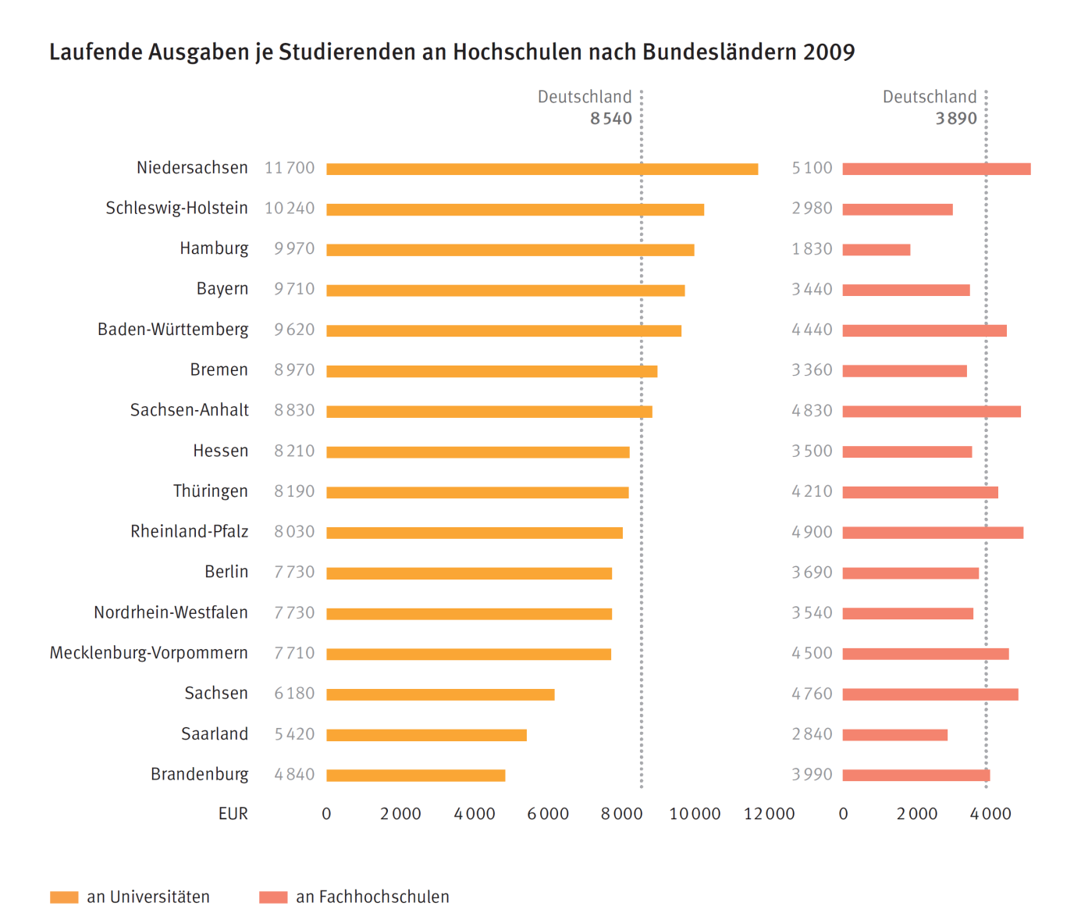
Institutional funding per student in the
16 states
Source: Hochschulen auf einen Blick.
Statistisches Bundesamt 2012

Slide 23
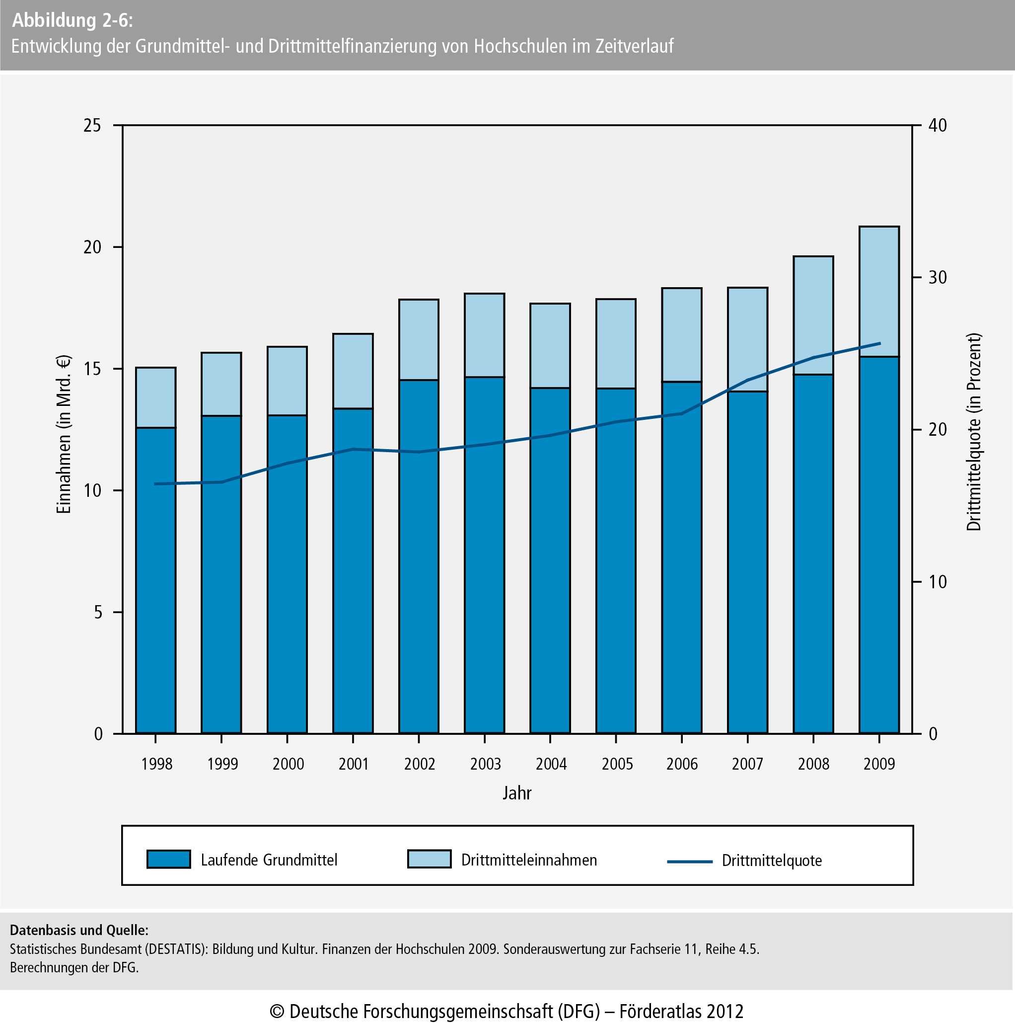
Institutional state funding vs. third-party funding

Slide 24
Agenda
The context
Outlines of the funding system
Mechanisms of state funding
Some figures on funding
Lessons learnt

Slide 25
Lessons learnt
There is no one-size-fits-all solution. It depends on size of
the state, negotiation culture, data quality, historical
differences etc.
The use of indicators stimulates discussions and
transparency, has incentive effects, even if distributed funds are low.
HEI appreciate the individualization of performance
measurement through target agreements.

Slide 26
Lessons learnt
But target agreements could be dangerous (dangers for
autonomy, bureaucracy, inflexibility …), yet the right
methods could avoid this.
A combination of formula funding and target agreements
has advantages (for instance rewards + pre-funding,
efficiency + focused discussions).
Negative impact of indicators on quality is often assumed,
but there are no proofs.

Slide 27
Lessons learnt
Typical frustrations occur because of zero-sum games, discretionary political funding, vicious circles.
Isolated development of funding systems is problematic,
close link to autonomy, reporting, competences for
internal allocation has to be taken into account.
Technical issues matter (formula construction,
guidelines for performance contracts, processes etc.).

Slide 28
Thank you for your attention! frank.ziegele@che.de

